Slide 1
the ANNEXATION process
CITY ADMINISTRATOR jori burnett
ASSISTANT PLANNER jesse ashbaugh
APRIL 5, 2021
FERNDALE CITY COUNCIL

Slide 2
TOPICS
topics
annexation background
GMA
annexation process
general conclusions
CITY ADMINISTRATOR jori burnett
ASSISTANT PLANNER jesse Ashbaugh
APRIL 5, 2021
FERNDALE CITY COUNCIL

Slide 3
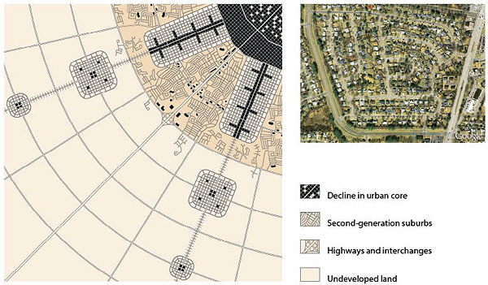

Slide 4
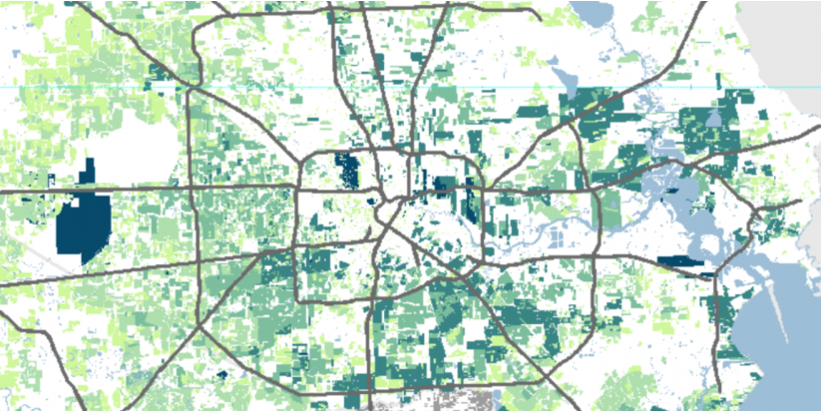
ANNEXATION BACKGROUND
KINDER INSTITUTE

Slide 5
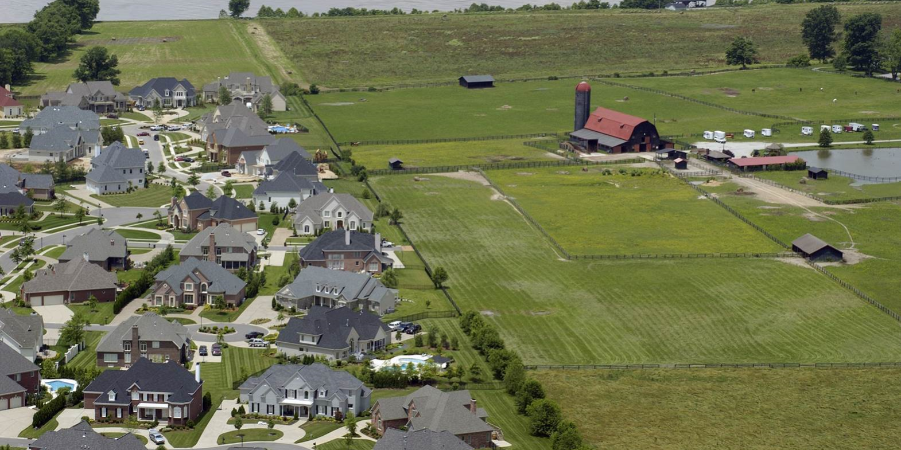
ANNEXATION BACKGROUND

Slide 6
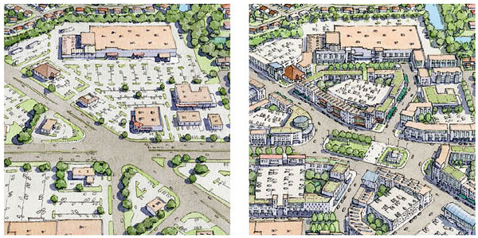
ANNEXATION BACKGROUND
ANNEXATION BACKGROUND

Slide 7
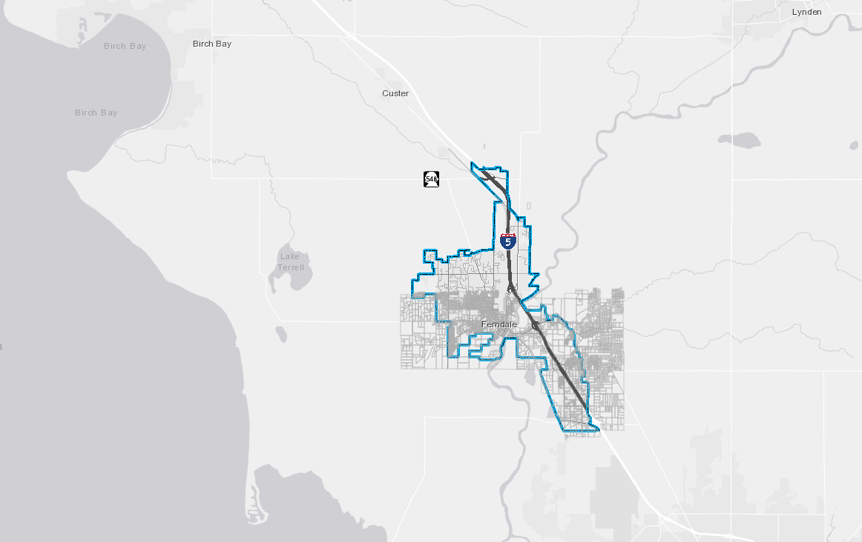
ANNEXATION BACKGROUND
~1970’S CONCEPTUAL SERVICE AREA

Slide 8
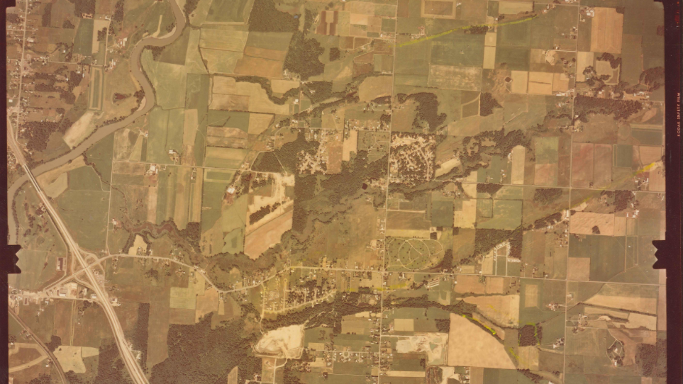
ANNEXATION BACKGROUND (1976)

Slide 9
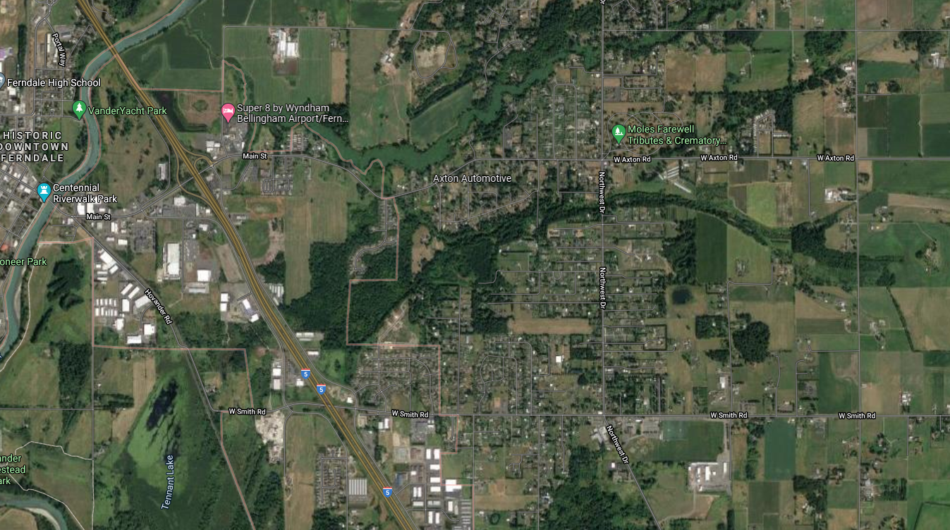
ANNEXATION BACKGROUND
UGA/CITY
UNINCORPORATED/
COUNTY

Slide 10
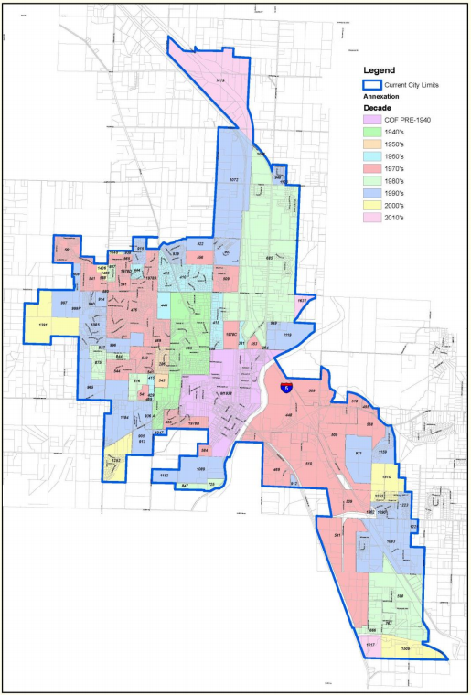
GMA

Slide 11
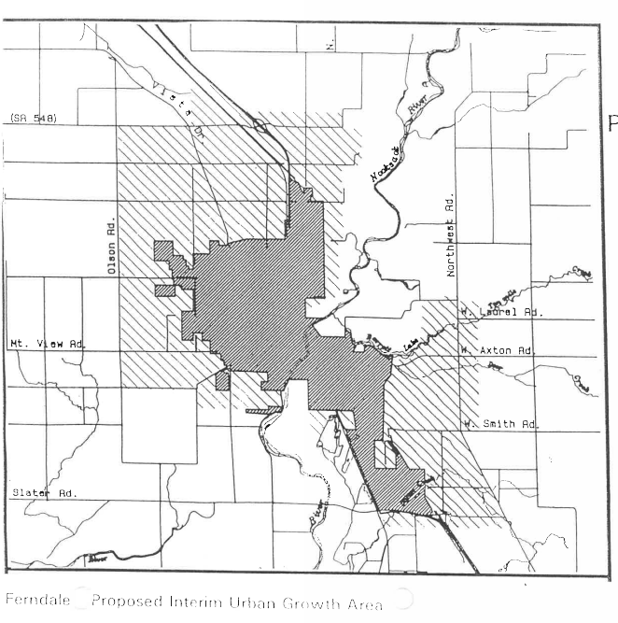
GMA
INTERIM UGA: ~1991-~1997

Slide 12
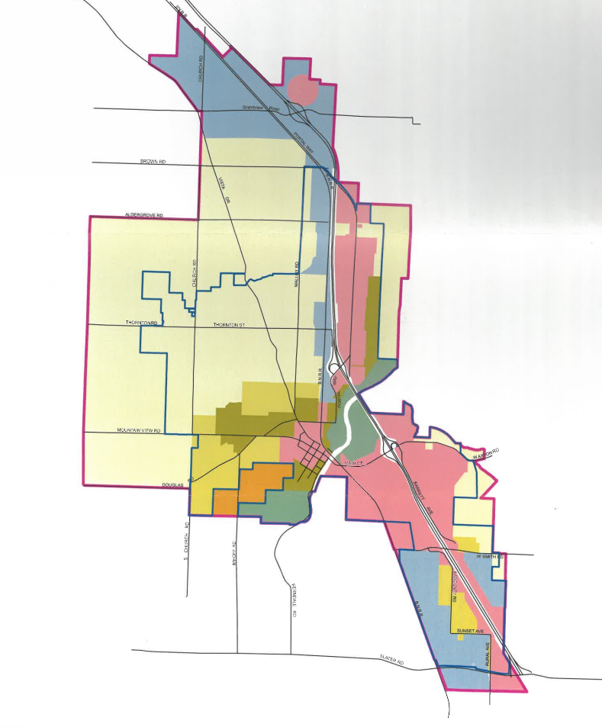
GMA
UGA ~1997 - ~2011
UTILIZED SHORT AND LONG-TERM UGA AREAS (NOT SHOWN)
COUNTY CREATED AND ENFORCED
NOT BASED ON CITY LONG-RANGE PLANS

Slide 13
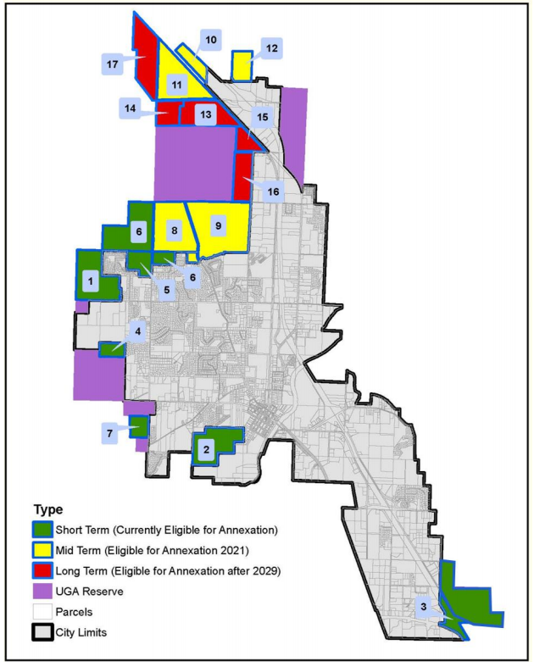
GMA
ANNEXATION PHASING PLAN/ANNEXATION BLUEPRINT (2011, UPDATED 2016)
CITY-CREATED
NOT DRIVEN BY COUNTY
BASED ON CAPITAL PROJECTS, UTILITY EXTENSIONS, LOGICAL ANNEXATION AREAS
INTENDED TO PRESERVE ADEQUATE DEVELOPMENT INVENTORY

Slide 14
THE ANNEXATION PROCESS
PROPERTY OWNERS INITIATE PRE-ANNEXATION MEETING
ARE PROPERTIES ELIGIBLE?
ANNEXATION PROCESS IN GENERAL
PROPERTY OWNERS SUBMIT PETITION TO ANNEX
PLANNING COMMISSION HEARING
COUNCIL HEARING
WHATCOM COUNTY/BRB COORDINATION
PROPERTY OWNERS SUBMIT NOTICE OF INTENT TO ANNEX
INCLUDES AT LEAST 10% OF ASSESSED VALUE
DIRECT TO COUNCIL
PROPERTY OWNERS INITIATE PETITION TO ANNEX
INCLUDES AT LEAST 60% OF ASSESSED VALUE
OWNERS PAY FOR FISCAL IMPACT ASSESSMENT
CITY ADMINISTERS FIA REVIEW
PROPERTY IS ANNEXED
NEIGHBORHOOD CENSUS
STATE ACCEPTANCE
PROPERTY OWNERS INITIATE NEIGHBORHOOD MEETING
DETERMINE NEIGHBOR INTEREST
ANSWER GENERAL QUESTIONS

Slide 15
GENERAL CONCLUSIONS
EXCEPT IN RARE CASES, ANNEXATIONS ARE INITIATED BY THE PROPERTY OWNER
FERNDALE HAS NOT ANNEXED LAND IN OVER A DECADE = LAND INVENTORY REDUCED
THE ANNEXATION PHASING PLAN MAY NEED TO BE UPDATED
DO NOT VIEW ANNEXATIONS AS PROFIT GENERATORS (ESPECIALLY RESIDENTIAL)
ANNEXATION ANNEXES LAND AND EXISTING LAND USES
FUTURE DEVELOPMENT WILL ALWAYS BE UNCERTAIN

Slide 16
questions?

