Slide 1
CITY FACILITY UPDATE
Interim Improvements
Jury Trials
Permanent Facilities

Slide 2
DISCUSSION TOPICS
FACILITIES BACKGROUND
INTERIM COURT IMPROVEMENTS
TEMPORARY COURT DISPLACEMENT
PERMANENT FACILITIES

Slide 3
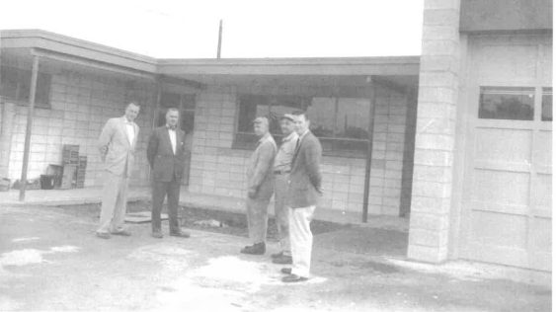
FACILITIES BACKGROUND
CITY MUNICIPAL COURT/COUNCIL CHAMBERS (1959), CITY HALL (1983)
MUNICIPAL COURT:
DOES NOT MEET MINIMUM WASHINGTON STATE SAFETY AND SECURITY ELEMENTS (VARIOUS)
DOES NOT PROVIDE ADEQUATE SPACE FOR CLIENT CONSULTATION
LACKS ADEQUATE SPACE FOR JURY TRIALS
OUTDATED HVAC EQUIPMENT
WORN FIXTURES AND FURNITURE
INADEQUATE SIZE FOR GROWING CITY
CITY HALL:
DOES NOT MEET MINIMUM WASHINGTON STATE SAFETY AND SECURITY ELEMENTS (VARIOUS)
DOES NOT PROVIDE ADEQUATE SPACE FOR CLIENT CONSULTATION
LACKS ADEQUATE SPACE FOR JURY TRIALS
OUTDATED HVAC EQUIPMENT
WORN FIXTURES AND FURNITURE
INADEQUATE SIZE FOR GROWING CITY

Slide 4
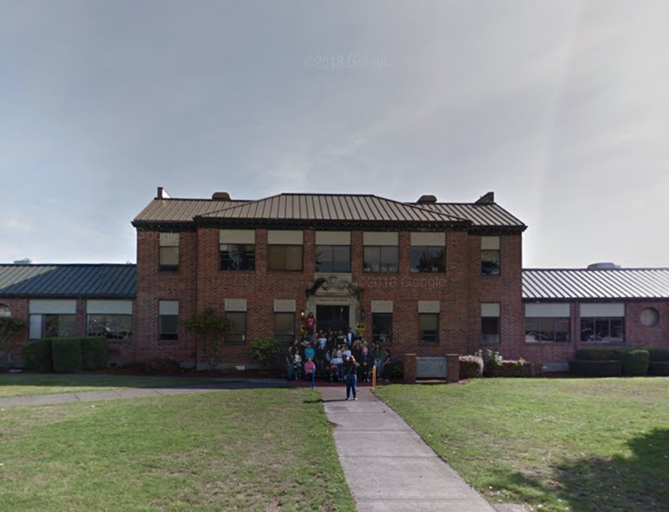
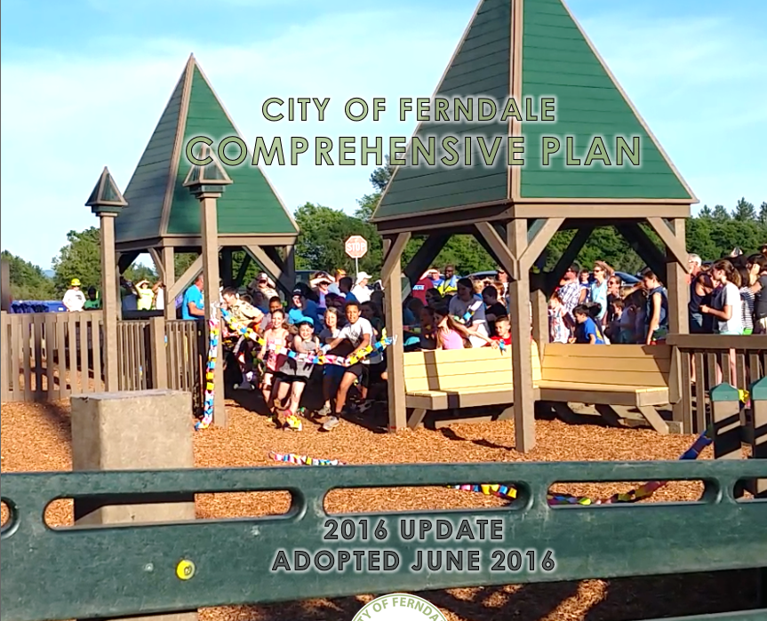
FACILITIES BACKGROUND
COMPREHENSIVE PLAN (2016): NEW OR EXPANDED CITY FACILITY PLANNING SHOULD BEGIN, NEW FACILITIES IN PLACE BY MID 2020’S
2019, 2020 (COUNCIL DISCUSSIONS): CO-LOCATION OF FACILITIES PREFERRED, DOWNTOWN LOCATION PREFERRED.
2019: OLD MAIN PROPOSAL DECLINED, “FULL” BANKED CAPACITY DECLINED
2019 (2020 BUDGET): INTERIM COURTROOM IMPROVEMENTS TO ADDRESS SECURITY/SAFETY SHOULD BE COMPLETED AS SOON AS POSSIBLE

Slide 5
FACILITIES BACKGROUND
2020 OBJECTIVES (FROM 2019):
INTERIM COURT IMPROVEMENTS
INITIATE DESIGN AND DETERMINE LOCATION FOR PERMANENT FACILITIES
PROGRESS ON FUNDING FOR PERMANENT FACILITIES

Slide 6
FACILITIES BACKGROUND
COVID: THINGS HAVE CHANGED
PERMANENT FUNDING WILL NOT BE PURSUED IN 2020
PLANNING AND DESIGN FOR INTERIM IMPROVEMENTS WERE DELAYED
INCORPORATION OF COVID-RELATED MODIFICATIONS
PERMANENT FACILITY PLANNING HAS BEEN SCALED DOWN
INSTEAD INITIATED COST-EFFECTIVE INTERNAL EVALUATION OF SPACE AND PROGRAMMING NEEDS

Slide 7
FACILITIES BACKGROUND
DECISION POINTS
MAINTAIN CONCLUSIONS THAT NEW OR EXPANDED CITY FACILITIES ARE OR WILL BECOME NECESSARY
MAINTAIN CONCLUSIONS THAT CO-LOCATED FACILITY, DOWNTOWN LOCATION ARE PREFERRED
SUPPORT STAFF CONCLUSIONS THAT PERMANENT FUNDING DECISION IS NOT POSSIBLE IN 2020.

Slide 8
INTERIM COURT IMPROVEMENTS
ENCLOSE BREEZEWAY: EXPANDS WEATHER PROTECTION, ESTABLISHES SEPARATE SECURITY SCREENING AREA

Slide 9
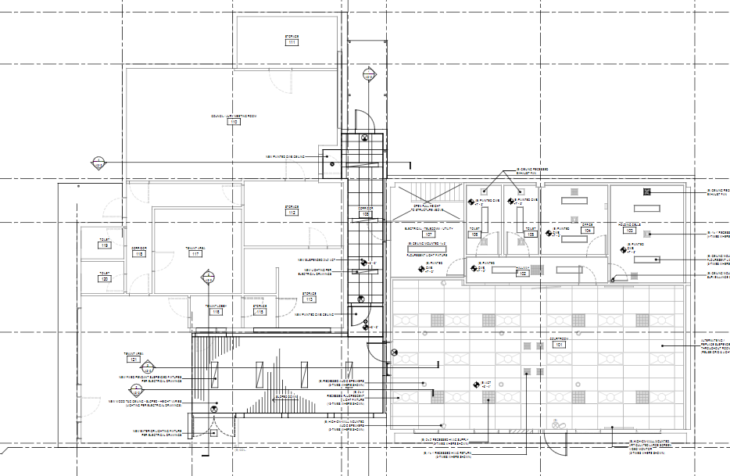
INTERIM COURT IMPROVEMENTS
ENCLOSURE CREATES ADDITIONAL EASTERN DOORWAY, MODIFIES EXISTING INTERIOR DOORWAYS, REPLACES EXISTING ROOF IN THIS AREA
MODIFICATION TO CHAMBER DOORS: FACILITATES SECURITY AND COVID ENTRY/EXIT RESTRICTIONS

Slide 10
INTERIM COURT IMPROVEMENTS
COST ESTIMATE (PRE-BID): $400,000
A BUDGET AMENDMENT WILL BE REQUIRED
THE CITY CAN SUSTAIN THIS COST, UTILIZING GENERAL FUND, REET, CARES FUNDING
TIMELINE: 36-40 WEEKS
CONTRACT WILL SPECIFY FOUR 10-HOUR SHIFTS PER WEEK

Slide 11
INTERIM COURT IMPROVEMENTS
DECISION POINTS:
NATURE OF IMPROVEMENTS: MINIMUM TO COMPLY WITH SAFETY AND SECURITY STANDARDS. IMPROVEMENTS ARE PROFESSIONALLY DESIGNED AND COMPLETE, BUT DO NOT RESOLVE THE MANY LONG-STANDING ISSUES.
BID AWARD: THE COST OF CONSTRUCTION WILL HAVE FEW MEANINGFUL VARIABLES THAT THE CITY CAN INFLUENCE; STAFF CAN FIND NO BENEFIT IN FURTHER DELAY

Slide 12
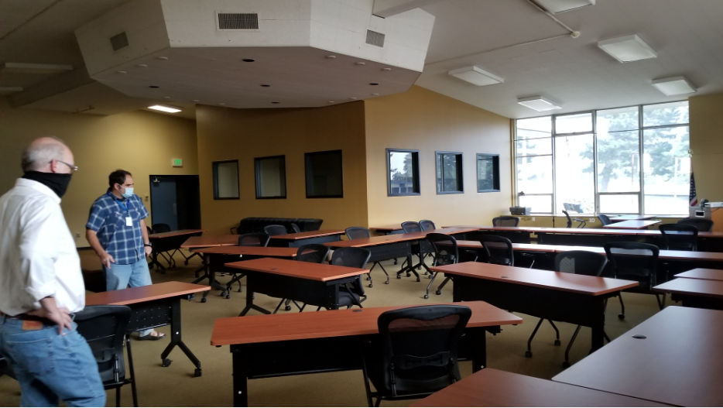
TEMPORARY COURT DISPLACEMENT
JURY TRIALS: MOUNTAIN VIEW ELEMENTARY MEETING ROOM (PREFERRED OPTION)
CITY/ DISTRICT AGREEMENT WILL BE REQUIRED (OCT. 5 COUNCIL)
TURN-KEY READY; REQUIRES ONLY AUDIO, JUDGE PLATFORM (CITY-OWNED)

Slide 13
TEMPORARY COURT DISPLACEMENT
COURT: OPTIONS UNDER REVIEW
COURT MAY CONTINUE DURING SOME CONSTRUCTION
POTENTIAL TO SUSPEND COURT PERIODICALLY (BASED ON CONSTRUCTION)
PIONEER PAVILION
MT VIEW ELEMENTARY
CONCLUSIONS
SEVERAL GOOD OPTIONS
LONG CONSTRUCTION PERIOD MAY REQUIRE MULTIPLE OPTIONS

Slide 14
TEMPORARY COURT DISPLACEMENT
DECISION POINTS
DISTRICT/CITY USE OF MT VIEW ELEMENTARY FOR JURY TRIALS (AND POTENTIALLY COURT): OCTOBER 5
COURT DISPLACEMENT: ARE THEY ANY OPTIONS THAT COUNCIL IS UNCOMFORTABLE WITH? MOST SCENARIOS WILL NOT REQUIRE FURTHER COUNCIL APPROVAL.

Slide 15
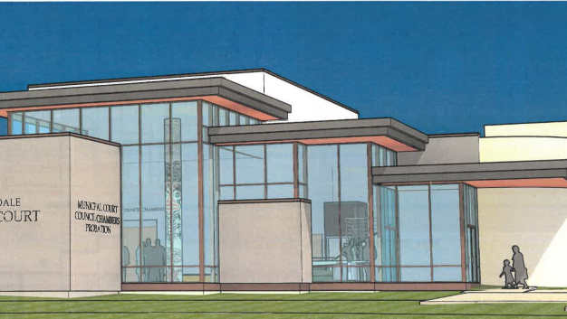
PERMANENT FACILITIES
INITIAL 2020 PLANS TO DEVELOP PLANS WERE SCALED BACK
FACILITY PLANNING DOCUMENTS FROM ~2005-2019 PROVIDE DEEP BACKGROUND
PLANNING DOCUMENTS ARE DATED
RECENT FACILITY PLANNING TOOK A SOLUTION-BASED APPROACH, RATHER THAN DOCUMENTING THE NEEDS

Slide 16
PERMANENT FACILITIES
CONCLUSIONS
ADVANCEMENTS IN PLANNING COULD STILL BE MADE IN 2020, FOR LESS COST
RE-ASSESSMENT OF NEEDS
EARLY DISCUSSION OF CONCEPTUAL ARCHITECTURAL GOALS
NARROWING DOWN (OR SELECTION OF) PREFERRED LOCATION(S)
FUNDAMENTAL 2020 GOAL: UNDERSTAND WHO WE ARE, WHAT WE NEED, AND WHERE WE WANT TO BE – AND BE ABLE TO PROVIDE THAT INFORMATION TO A DESIGN TEAM IN THE FUTURE.

Slide 17
PERMANENT FACILITIES
CITY HAS CONTRACTED WITH JANELLE DIXON, RECENT WSU ARCHITECTURAL SCHOOL MASTERS GRADUATE
SCOPE INCLUDES NEEDS SURVEY/ASSESSMENT, GENERAL ARCHITECTURAL GOALS, INITIAL SPACE PROGRAMMING, ASSISTANCE IN SITE SELECTION

Slide 18
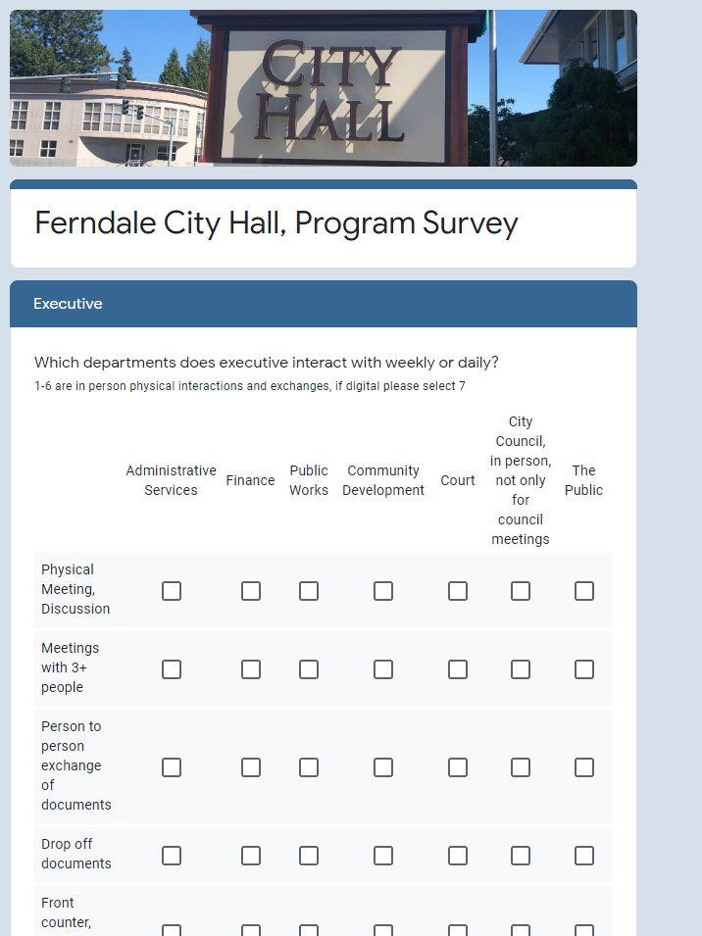
PERMANENT FACILITIES
SURVEY
INTENDED TO IDENTIFY SPACE NEEDS, RELATIONSHIP BETWEEN DEPARTMENTS.
SURVEY IS STAFF-LEVEL, INITIATED WEEK OF SEPT. 14TH
KEY CHANGE FROM PREVIOUS ANALYSIS: INCLUDES UPDATED ASSUMPTIONS, RAW NUMBERS WILL BE REFINED AND ANALYZED (ELIMINATION OF REDUNDANCIES, CLARIFICATION OF DIFFERENT EXPECTATIONS AMONGST DEPARTMENTS)
ANTICIPATE MODERATELY LESS SPACE NEEDS THAN PREVIOUS PLANNING EXERCISE

Slide 19
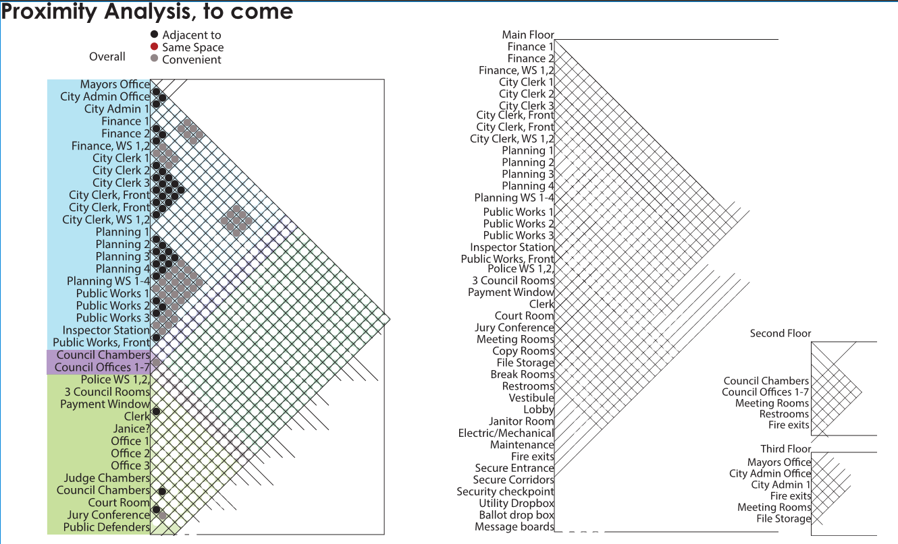

Slide 20
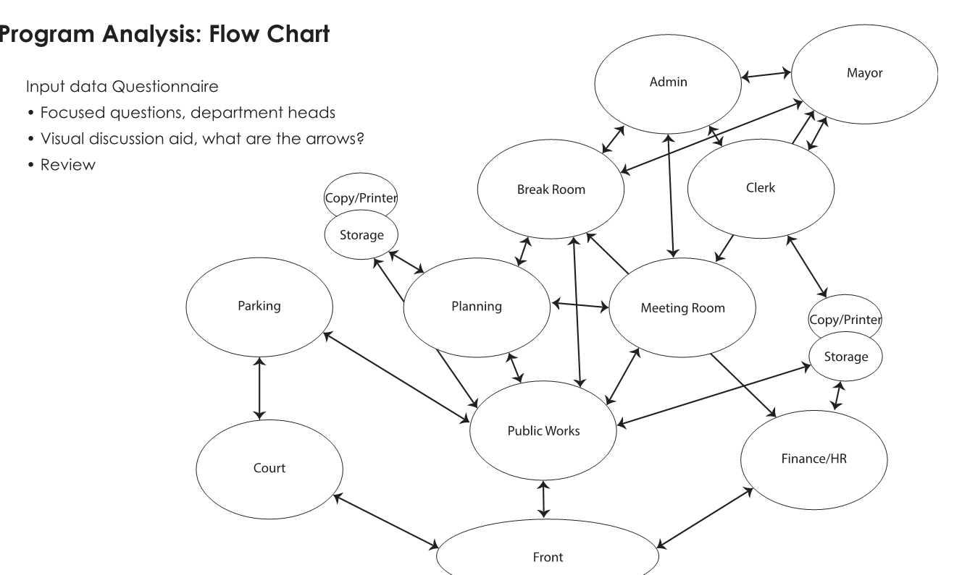

Slide 21
PERMANENT FACILITIES
LOCATION
STAFF DOES NOT BELIEVE THAT ADDITIONAL PLANNING BEYOND A NEEDS ASSESSMENT CAN BE COMPLETED UNTIL A SITE IS IDENTIFIED AND SECURED.
ANY BUILDING DESIGN WILL RELY HEAVILY ON SITE CONDITIONS, CONFIGURATION, AND SIZE
PLANNING FOR A LOCATION NOT CURRENTLY UNDER CITY CONTROL WILL REQUIRE ADDITIONAL UP-FRONT COSTS (LEASE, OPTIONS, PURCHASE)
DELAY IN FURTHER PLANNING UNTIL A NEW SITE IS SECURED COULD RESULT IN IMPACTS TO CITY SERVICES

Slide 22
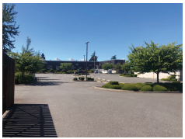
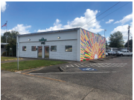
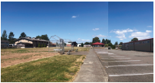
PERMANENT FACILITIES
LOCATION
STAFF RECOMMENDS REDUCING SCOPE OF POTENTIAL LOCATIONS TO EXISTING DOWNTOWN CITY PROPERTIES
CIVIC CAMPUS
COUNCIL CHAMBERS
PIONEER PAVILION FIELD

Slide 23
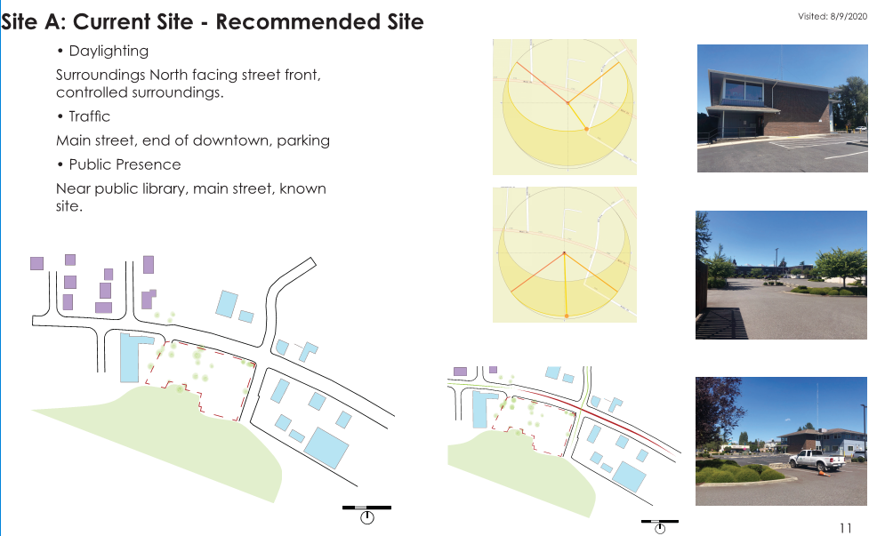

Slide 24
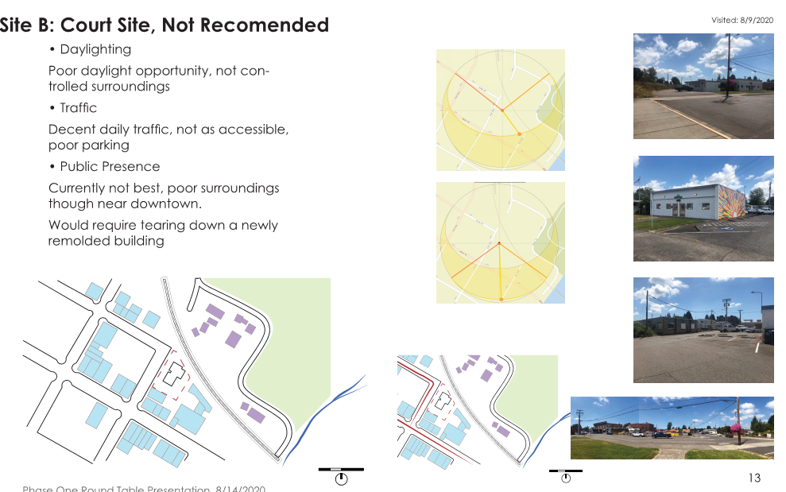

Slide 25
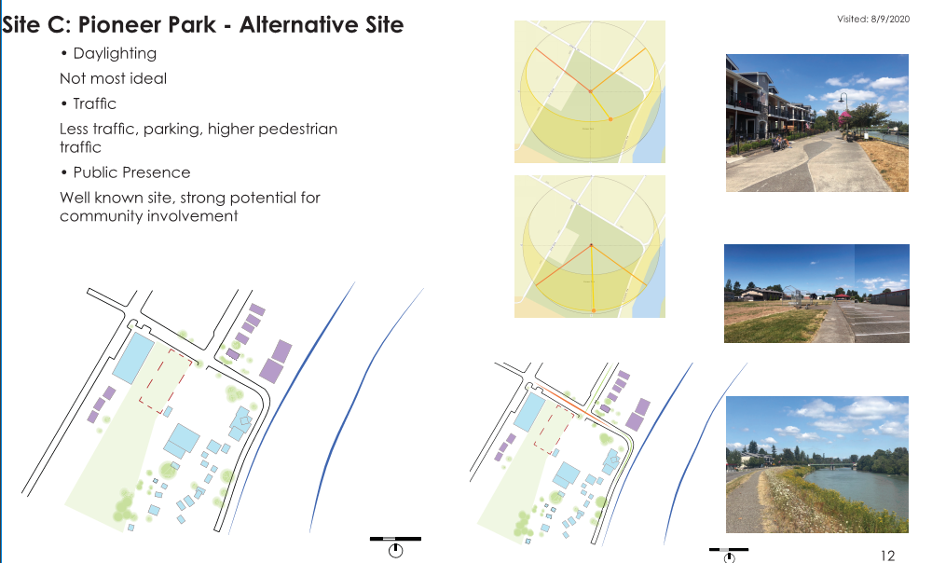

Slide 26
PERMANENT FACILITIES
DECISION POINT:
THE CITY COUNCIL IS ASKED TO CONSIDER STAFF’S RECOMMENDATION THAT THE CIVIC CAMPUS SITE BE CONSIDERED THE PREFERRED ALTERNATIVE. NO DECISION IS EXPECTED TONIGHT.
STAFF WOULD SEEK TO DEVELOP SPACE PROGRAMMING REQUIREMENTS AND CONCEPTUAL ARCHITECTUAL CONFIGURATIONS ON THIS SITE ONLY IN 2020 (NO ADDITIONAL FUNDING IS NECESSARY)
SUBSEQUENT (2021 AND BEYOND) BUDGET EXPENDITURES WOULD BE BASED ON THE CIVIC CAMPUS SITE, UNLESS OTHERWISE DIRECTED BY COUNCIL

Slide 27
PERMANENT FACILITIES
CONCLUSIONS:
STAFF BELIEVES 2020 SPACE NEEDS AND PROGRAMMING WILL RESULT IN A DURABLE DOCUMENT FOR CONSTRUCTION THIS DECADE
THE CIVIC CAMPUS SITE HAS CONSISTENTLY BEEN IDENTIFIED AS A PREFERRED SITE THROUGH PREVIOUS STUDIES, WITH THE EXCEPTION OF FLOODPLAIN AND CRITICAL AREAS CONCERNS, WHICH STAFF BELIEVE WERE GIVEN UNDUE WEIGHT BASED UPON DEVELOPMENT OPTIONS AND BUILDING LOCATION

