Slide 1
CITY OF FERNDALE
APPEALS
&
THE APPEALS PROCESS

Slide 2
AGENDA
WHY ARE APPEALS NECESSARY?
TYPES OF APPEALS
APPEAL PROCEDURES
OTHER APPEALS
FINAL DECISIONS
ADDITIONAL CONSIDERATIONS

Slide 3
WHY ARE APPEALS NECESSARY?
AN APPEAL IS A FORMAL REQUEST MADE BY A PARTY OF RECORD FOR A HIGHER DECISION-MAKING AUTHORITY TO REVIEW THE FINAL DECISION MADE BY A DESIGNATED MUNICIPAL AUTHORITY.

Slide 4
WHY ARE APPEALS NECESSARY?
BY LAW, LOCAL JURISDICTIONS MUST PROVIDE AN APPEALS PROCESS
PROCESS NOT TO BE OVERLY BURDENSOME – REASONABLE APPEAL FEE
DESIGNED TO ENSURE THAT LOCAL DECISION-MAKING IS BASED ON ADOPTED LAW AND PROCEDURE
PARTIES OF RECORD HAVE THE OPPORTUNITY TO FORMALLY APPEAL ADMINISTRATIVE DECISIONS
AGGRIEVED PARTIES HAVE THE OPPORTUNITY TO APPEAL ADMINISTRATIVE DECISIONS AND ENFORCEMENT ACTIONS.

Slide 5
PROS AND CONS OF APPEALS
APPEALS CAN BE FULL OF CONFLICT. THEY ARE OFTEN FILED AFTER PROTRACTED DEBATE OVER DETERMINATIONS/CONDITIONS AND BAD FEELINGS MAY ALREADY EXIST.
HOWEVER, APPEALS ARE A TOOL FOR RESOLVING IMPASSES: REASONABLE PEOPLE MAY INTERPRET CODE DIFFERENTLY. IT HELPS TO HAVE A NEUTRAL THIRD-PARTY OVERSEE THE CONFLICT.
APPEALS CAN IMPROVE OUR CODES AND PROCEDURES BY CALLING ISSUES OF INTERPRETATION/INCONSISTENCIES TO OUR ATTENTION.
APPEALS CAN ALSO BE A COMPLETE WASTE OF TIME
IN MANY CASES, GETTING TO A FINAL DECISION AND PROVIDING APPEAL RIGHTS QUICKLY IS BEST, AS NEITHER THE CITY OR APPLICANT HAVE YET INVESTED IN THE ARGUMENT.

Slide 6
TYPES OF APPEALS
TYPE OF DECISION | FMC | DECISION MAKER
LAND USE DECISION | 14.11.070 | STAFF OR COUNCIL
CODE INTERPRETATION | 14.11.070 | CDD/PW DIRECTORS OR DESIGNEE
ENFORCEMENT ACTION | 1.12 | DIRECTOR
BUSINESS LICENSE ISSUANCE/DENIAL | 5.04.060 | FINANCE DIRECTOR
BUILDING PERMIT DECISIONS | 2.25, 14.11 | BUILDING OFFICIAL
HEARING EXAMINER DECISIONS |  | SUPERIOR COURT
LEGISLATIVE DECISIONS/SHORELINE |  | GMHB/SHORELINE HEARINGS BOARD

Slide 7
APPEAL PROCEDURES
LAND USE, ENFORCEMENT,BUSINESS LICENSE, BUILDING* DECISIONS
ADMIN DECISION
STAFF ISSUES FINAL WRITTEN DECISION
APPEAL
APPEAL FILED WITHIN 10 DAYS
HEARING EXAMINER SCHEDULES HEARING
EXAMINER DECISION*
STAFF DEVELOPS STAFF REPORT
H.E. CONSIDERS ARGUMENTS, RENDERS DECISION
* THE HEARING EXAMINER ACTS AS THE BOARD OF APPEALS IN APPEALS OF BUILDING DECISIONS, WHICH ARE BASED ON ADOPTED UNIFORM AND INTERNATIONAL CODES

Slide 8
WHO CAN APPEAL?
TYPE OF DECISION | POTENTIAL APPELLANT | TIMELINE FOR APPEAL
LAND USE DECISION | AGGRIEVED PERSON | 10 DAYS AFTER DECISION
CODE INTERPRETATION | AGGRIEVED PERSON | 10 DAYS AFTER DECISION
ENFORCEMENT ACTION | PROPERTY OWNER OR NAMED INDIVIDUAL | 72 HOURS (SWO, EMERGENCY); 10 DAYS AFTER NOV
BUSINESS LICENSE ISSUANCE/DENIAL | APPLICANT OR PERSON OBJECTING TO ISSUANCE | 10 DAYS AFTER ISSUANCE/DENIAL
BUILDING PERMIT DECISIONS | APPLICANT OR PROPERTY OWNER | 10 DAYS AFTER INTERPRETATION OR DECISION RELATED TO BUILDING CONSTRUCTION METHODS
APPEAL PROCEDURES

Slide 9
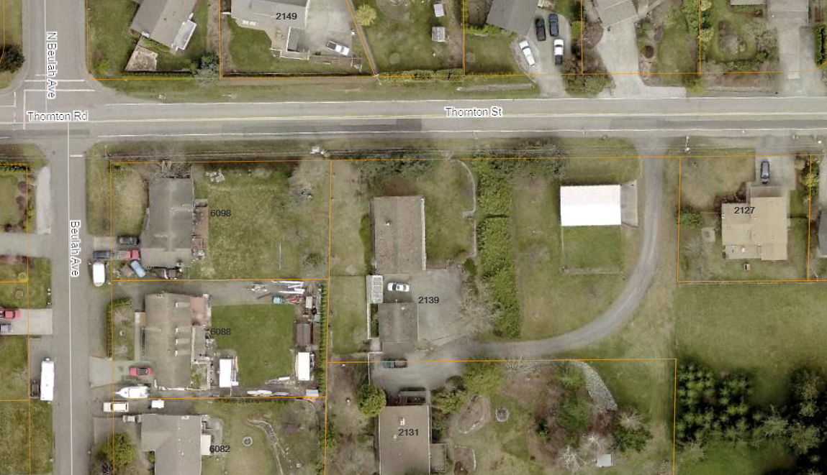
THE PROCESS: ADMINISTRATIVE DECISION
SCENARIO: OFFSITE TRAFFIC MITIGATION
City requires installation of offsite crosswalk.
APPEAL PROCEDURES
Two-lot short plat proposed (one additional residence)

Slide 10
THE PROCESS: ADMINISTRATIVE DECISION
SCENARIO: OFFSITE TRAFFIC MITIGATION
THE CITY MAY BE CORRECT THAT THE EXISTING CROSSWALK IS MISSING OR NEEDS IMPROVEMENT
BUT WHAT BASIS DOES THE CITY HAVE TO REQUIRE THAT THE APPLICANT CONSTRUCT THE CROSSWALK?
DOES THE NATURE OF THE PROPOSAL ALLOW FOR OFFSITE MITIGATION?
ARE THE CONDITIONS IMPOSED RELATED TO THE IMPACTS FROM THE DEVELOPMENT?
E.g. WHAT IF THE DEVELOPMENT WON’T GENERATE PEDESTRIAN TRAFFIC?
IS THE MITIGATION PROPORTIONATE TO THE IMPACT, E.G., IT IS DOUBTFUL THE CITY WOULD SEEK TO REQUIRE THAT THE ENTIRE INTERSECTION BE IMPROVED – WHAT IS PROPORTIONATE?
IS THE CONDITION VALID UNLESS APPEALED (BETTER TO ASK FORGIVENESS THAN PERMISSION)?
APPEAL PROCEDURES

Slide 11
A FINAL DECISION REPRESENTS THE CITY ADMINISTRATION’S FINAL WORD ON A TOPIC.
FINAL DECISIONS SHOULD BE CLEARLY IDENTIFIED AND IN WRITING.
FINAL DECISIONS SHOULD REPRESENT THE LAST WORD, NOT THE INITIAL RESPONSE.
INITIAL FEEDBACK AND REVIEW COMMENTS DO NOT REPRESENT A FINAL DECISION.
CONDITIONS THAT HAVE BEEN IMPOSED AND ACCEPTED BY AN APPLICANT (I.E. NO APPEAL WAS FILED) CANNOT BE REVISITED WITH A “NEW” FINAL DETERMINATION ISSUED BY THE CITY.
IN CASES WHEN THE CITY HAS ARRIVED AT A FINAL CONCLUSION BUT IT DOES NOT CONSTITUTE A FINAL DECISION, THE APPLICANT MAY REQUEST AN ADMINISTRATIVE INTERPRETATION UNDER THE CODE, WHICH WOULD CONSTITUTE A FINAL APPEALABLE DECISION.
APPEAL RIGHTS MUST BE CLEARLY PROVIDED IN WRITING WHEN A FINAL DECISION IS ISSUED.
FINAL DECISIONS

Slide 12
PRIOR TO MAKING A FINAL DECISION:
DOES IT CONSTITUTE A “FINAL DECISION” FOR THE PURPOSES OF PROVIDING APPEAL RIGHTS?
IS THE DECISION SUPPORTED BY CODE?
DO YOU HAVE THE AUTHORITY TO MAKE SUCH A DECISION?
IS YOUR DECISION SUPPORTED BY THE APPLICABLE DIRECTOR?
ARE THERE ALTERNATIVES?
WILL THIS DECISION IMPACT ANOTHER DEPARTMENT? WILL THERE BE A DOMINO EFFECT THAT WILL IMPACT THE APPLICANT’S ABILITY TO COMPLY WITH OTHER REGULATIONS?
DOCUMENT THE DECISION PATH: VERBAL COMMUNICATION WITHOUT WRITTEN NOTES IS INADEQUATE. RESPOND TO EMAIL REQUESTS VIA EMAIL OR OTHER WRITTEN FORM (INTERNAL AND EXTERNAL).
DOES THIS DIRECTION REFLECT THE CITY’S INITIAL FEEDBACK PROVIDED TO THE APPLICANT?
IF NOT, WHY NOT? THE CITY IS OBLIGATED TO COMPLY WITH CODE, BUT IN SOME CASES THE FAILURE TO COMMUNICATE IN A TIMELY MANNER WITH THE APPLICANT CAN RESULT IN LOSING AN APPEAL OR REACHING A SETTLEMENT.
HAVE YOU EXHAUSTED ALL AVENUES WITH THE APPLICANT THAT WOULD RESOLVE THE ISSUE?
FINAL DECISIONS

Slide 13
APPEAL STAFF REPORTS
EXPECT THAT THE AUTHOR OF THE STAFF REPORT WILL BE RESPONSIBLE FOR TESTIFYING
THE PERSON WITH THE MOST EXPERTISE IN THE SUBJECT SHOULD DEVELOP THE STAFF REPORT
DO NOT RELY ON VERBAL TESTIMONY TO MAKE YOUR CASE
THE HEARING EXAMINER MAY NOT BE INTERESTED, MAY CUT YOU OFF, MAY NOT ASK YOU A QUESTION YOU WANT TO ANSWER (AND MAY ASK QUESTIONS YOU DO NOT WISH TO ANSWER)
IF THERE IS TESTIMONY THAT YOU WANT TO ENSURE GETS IN THE RECORD, PUT IT IN THE STAFF REPORT OR DISCUSS WITH CITY ATTORNEY.
SO YOU’VE BEEN APPEALED…
DO NOT MAKE STUFF UP
…EITHER IN THE STAFF REPORT OR DURING TESTIMONY. PROVIDE DATA AND BACKGROUND; IF YOU DO NOT KNOW, SAY YOU DO NOT KNOW. IF THERE IS SOMEONE MORE QUALIFIED TO SPEAK ON THAT SUBJECT, SAY SO ON THE RECORD, AND MAKE SURE THEY ARE AVAILABLE TO TESTIFY.
- THE CITY’S RECORD MUST BE COMPLETE AT THE TIME OF THE APPEAL HEARING. IN ALMOST ALL CASES THE RECORD CANNOT BE EXPANDED IN SUBSEQUENT APPEAL PROCEEDINGS AFTER THE HEARING EXAMINER HAS ISSUED A DECISION.

Slide 14
QUESTIONS?

Slide 15
APPEAL TIMELY FILED, FEES PAID
APPEAL DOCUMENTS SENT TO CITY ATTORNEY, HEARING EXAMINER (PATTI)*
CITY REVIEWS APPEAL DOCUMENTS: CAN AN APPEAL BE SUSTAINED?
APPROPRIATE DEPARTMENT HEAD DEVELOPS STAFF REPORT: REQUESTED ACTION, BACKGROUND, CODES CITED, GAPS IN APPELLANT’S ARGUMENT. CITY ATTORNEY PROVIDES BRIEF
HEARING: H.E. PROVIDES STAFF AND THE APPELLANT THE ABILITY TO MAKE THEIR ARGUMENTS (BASED ON STAFF REPORT, APPEAL DOCUMENTS). H.E. WILL OFTEN QUESTION BOTH PARTIES; CROSS EXAMINATION IS ALLOWED
IF AN APPEAL SHOULD BE FOUGHT, C.A. AND STAFF DEVELOP STRATEGY. IF NOT, C.A. AND STAFF SEEK NEGOTIATION OR RECONSIDERATION
STAFF REPORT DISTRIBUTED TO HEARING EXAMINER AND APPELLANT. IN SOME CASES APPELLANT MAY PROVIDE BRIEFING, REPORTS, OR OTHER DOCUMENTATION.
H.E. MAY INDICATE HIS DECISION AT THE HEARING BUT IS NOT REQUIRED TO DO SO. TYPICALLY A FORMAL DECISION IS ISSUED WITHIN 10 DAYS OF THE HEARING.
….WHAT HAPPENS NEXT?
SO YOU’VE BEEN APPEALED…
* PATTI IS RESPONSIBLE FOR MAINTAINING PAPERWORK FOR THE HEARING EXAMINER DURING THE APPEAL PROCESS; SHE DOES NOT PARTICIPATE IN THE DEVELOPMENT OF ANY STAFF REPORT OR STRATEGY DISCUSSIONS IN ORDER TO PRESERVE AN INTERNAL FIREWALL (SHE PROVIDES THE SAME SERVICE TO THE APPELLANT AND GENERAL PUBLIC)

