Slide 1
VESTING
OCTOBER 5, 2020
CITY OF FERNDALE
CITY COUNCIL MEETING

Slide 2
PRESENTATION OVERVIEW
WHAT IS VESTING?
HOW DOES VESTING WORK?
WHY IS VESTING IMPORTANT?

Slide 3
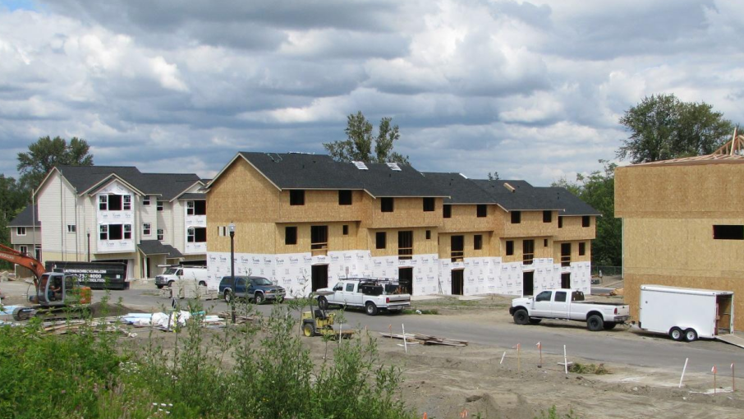
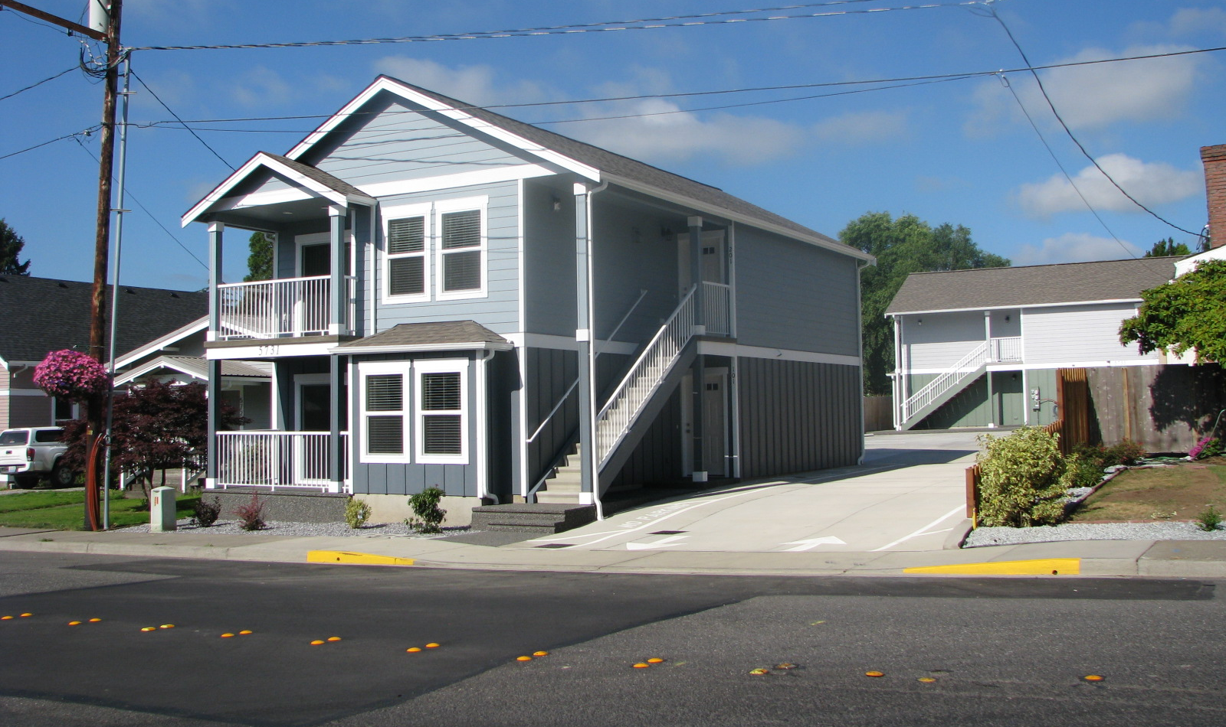
VESTING – FERNDALE CONTINUES TO GROW
CITY STAFF AND COUNCIL MEMBERS MAY EXPERIENCE FEEDBACK FROM THE PUBLIC.
“PLEASE, DO SOMETHING ABOUT THIS!”
Notes:
IT IS NOT UNCOMMMON FOR CITY COUNCIL MEMBERS, PLANNING COMMISIONERS OR CITY STAFF TO RECEIVE input from the public and sometimes it is even from friends, family or neighbors.
Out of the hands. Planned Unit Developments – Comphensive Plan Ex parte converstions.

Slide 4
VESTING – WHAT IS IT?
COURT DECISIONS
DECADES
STATE LAW
“IT’S COMPLICATED…”
Notes:
Vesting regulations for land use permit applications are relatively complex and have been formed and amended by state law and court decisions over the last several decades. Vesting regulations have been shaped by the legislature and a series of land use court cases over time.
State law governs the vesting of some permit applications (specifically building permit and subdivision applications. Court decisions over time have focused on other types of permit applications resulting in various vesting rights depending on the type of permit and the type of regulations subject to vesting. These court decisions confer what is called “common law vesting” for some permits.
Addressed in a court decision, or City can provide its own vesting regulations. We can’t more restrictive as more as timelines. Provide additional extensions over and beyond.

Slide 5
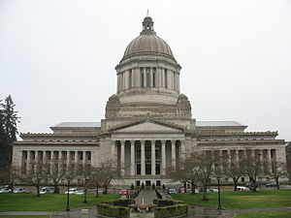
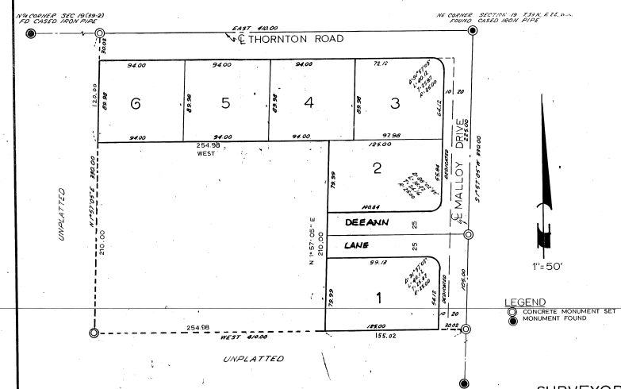
VESTING – WHAT IS IT?
STATUATORY VESTED RIGHTS APPLY TO BUILDING PERMITS, SUBDIVISIONS, AND DEVELOPMENT AGREEMENTS
Notes:
Statutory vested rights (meaning rights granted by the legislature in statute) in Washington State apply to building permits, subdivisions, and development agreements. Ferndale provides vested rights to building permits, subdivisions and short plats, binding site plans, planned unit developments, conditional use permits, and shoreline development permits. Except under limited circumstances, no other land use or environmental permits, or licenses have vested rights under State law, common law, or in Ferndale.
Code section

Slide 6
VESTING – HOW DOES IT WORK?
FIRST STOP: A COMPLETE APPLICATION
DETERMINATION OF COMPLETENESS
Notes:
In nearly all cases, the notion of a “complete application” is a basic starting point for the vesting discussion. For an application to be complete, it must contain an application for a project permit which meets the procedural submission requirements of the City and is sufficient for continued processing, even though additional information may be required or project modifications may subsequently occur. The application should also include all elements as required by the Ferndale Municipal Code. The information is required to be provided to be deemed complete, but it is not required to be “accurate” or “consistent” with regulations for the purposes of vesting. For example, if an applicant submitted a “Site Plan” that is difficult (or impossible) to read or is missing multiple site plan features such as the north arrow, scaled setbacks, the building outline, parking, utility tie in locations etc., staff must still consider this a complete submittal for vesting purposes. Staff can request a new site plan be provided to proceed with review. Similarly, an applicant may be able to significantly change the site plan themselves after submittal, while still retaining vested rights.
See FMC 14.03.030 for the complete definition of a “Complete Application.”

Slide 7
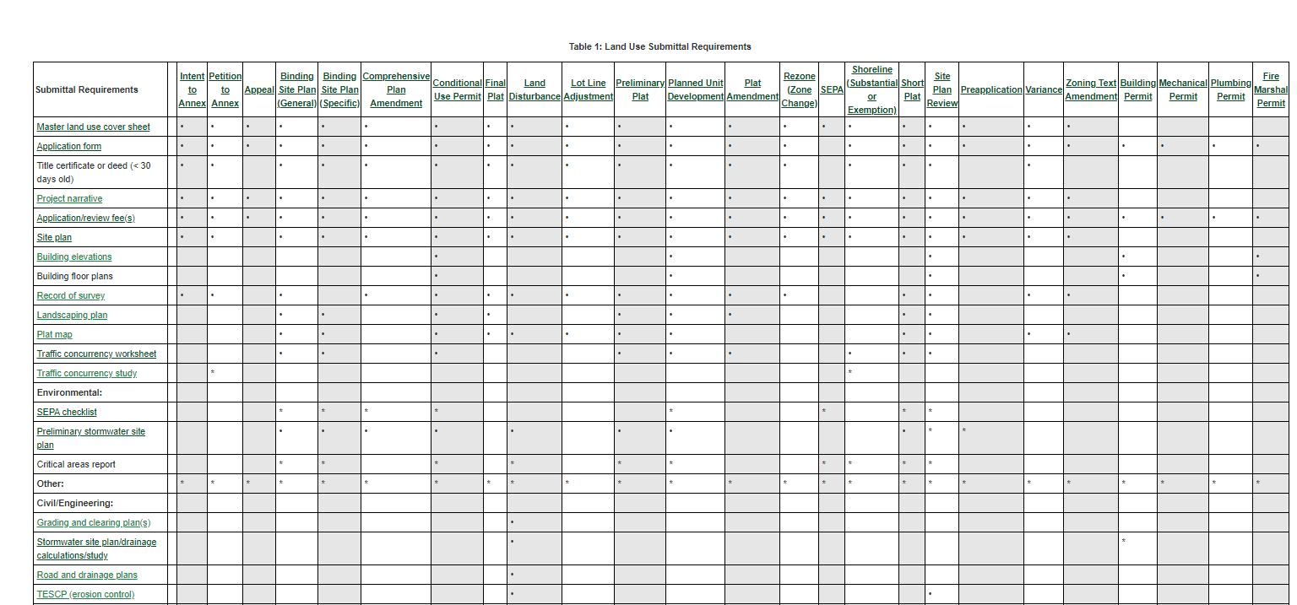

Slide 8
VESTING – HOW DOES IT WORK?
COMPLETE APPLICATION DATE – TIMING IS KEY!
CITY CENTER
ZONING CODE
EFFECTIVE: DECEMBER 30, 2018
FMC 1.1 – THE BUILDING CAN LOOK LIKE ANYTHING! THE SKY IS THE LIMIT.
COMPLETE APPLICATION
ON DECEMBER 11, 2019
CITY CENTER
ZONING CODE
EFFECTIVE: DECEMBER 12, 2019
FMC 1.1 – BUILDING MUST BE BUILT USING A PIONEER THEME ONLY!
Notes:
Applicants who submit completed applications (subdivisions, building permits and development agreements) are considered “vested” with the current zoning and land use regulations in place at the time of the complete application. The City cannot require applicants to comply with new regulations that were not in place at the time of vesting.
Development agreements are not common in Ferndale and apply to unique circumstances related to development proposals such as a site-specific requirement to allow a rezone or specific conditions related to a project such as the Catalyst projects.
For example, the City recently modified its multifamily zones and regulations to require that the site and building design meet more elevated design standards in the zone. If the applicant submitted a completed land use application before those regulations were adopted, the City could not then require those elevated design regulations for the project submitted (and deemed complete) under an original zoning code. This benefit cannot go “both ways,” however, meaning, the applicant cannot selectively choose which code to be vested under. This timing of which code applies to the project is simply and only determined by a complete application.

Slide 9
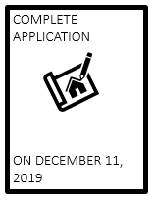
VESTING – HOW DOES IT WORK?
PERMIT MUST REMAIN “ACTIVE” OR, PERMIT MUST NOT “EXPIRE”
Notes:
Applicants must also keep the permit “active” and not allow it to expire. The building permit expiration timing is 180-days of inactivity during the application procedure or during inspection of the structure in the field. The City’s land use application expiration timelines vary. Once an application has expired, all vested rights are lost.
The City’s regulations (consistent with state law in RCW 58.17.170) currently protect subdivisions from land use changes for a period of five years after approval (preliminary or final), with the potential for a two-year extension. Infrastructure (with exception to stormwater) may also be considered protected during this five to seven-year construction period, provided that the infrastructure (with the exception of stormwater) was originally designed to support proposed development. However, following the conclusion of the five to seven-year construction period, vesting protections will lapse. Once vesting protections lapse, legally subdivided lots (recorded in a final plat) will still be considered legal lots of record; however, any development on those lots will then be subject to current regulations.
Stormwater regulations and certain other environmental regulations are not considered a “land use action,” and are therefore not subject to vesting, based on a X decision. The relatively recent decision, which tended to diverge from the common practice in many jurisdictions of considering the entirety of regulations that would apply to development as “land use regulations,” illustrates the extent to which the concept of vesting in Washington State continues to evolve.

Slide 10
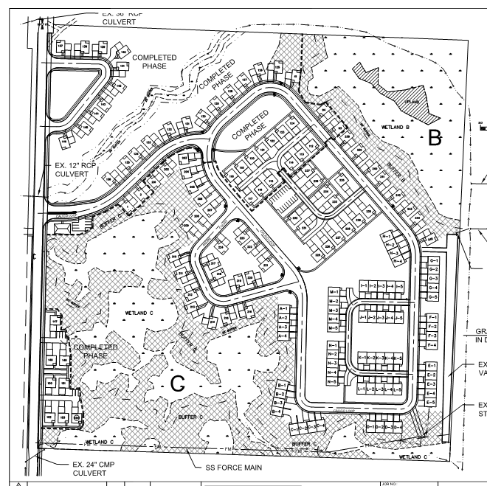
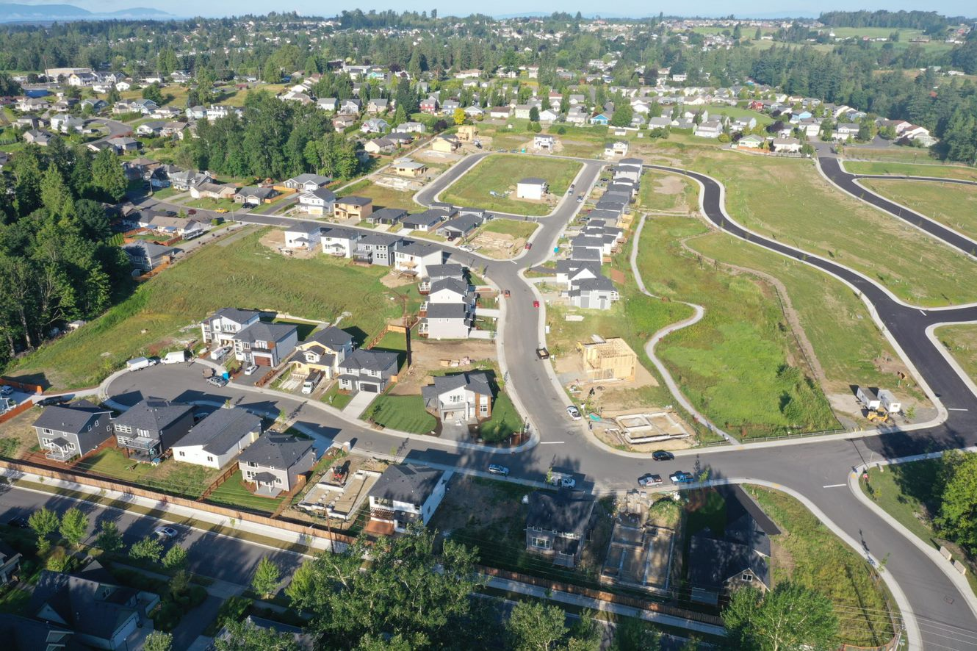
VESTING – HOW DOES IT WORK?
KEEPING A PERMIT ACTIVE – A SUBDIVISION SCENARIO
PRELIMINARY PLAT APPROVAL: NOTICE OF DECISION
ON DECEMBER 11, 2015
Notes:
For example, if a residential or commercial subdivision, together with installed infrastructure, roadways, water mains, sewer mains, utility stub outs and storm water ponds, vaults or bioswales (etc) meeting all current requirements is given final approval in 2015, the proponents will have five years (with a possible two year extension) to achieve build out of all lots (for all infrastructure, with the exception of stormwater infrastructure). During that time, the City will not require that the (road, water, and sewer) infrastructure be reconfigured to meet updated utility standards, even if the standards change. The City also cannot amend the zoning to exclude the previously intended uses. However, after the conclusion of this five to seven-year period, all future development shall be required to meet requirements of the current code(s) at that time, including environmental regulations like shoreline and critical areas regulations. Land uses constructed prior to a zoning change will generally be considered legal non-conforming uses and will be generally protected as long as the use is not abandoned.

Slide 11
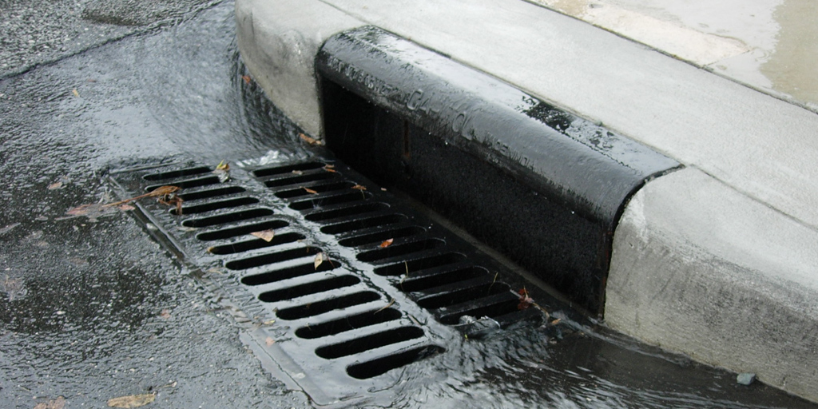
VESTING – HOW DOES IT WORK?
STORMWATER REGULATIONS DO NOT VEST HOWEVER; THERE ARE “PROTECTED TIMELINES.”
Notes:
Stormwater regulations are more complicated in the sense that the requirements do not “vest” to a specific permit timeline. Rather, the project is required to comply with the “protected timelines” identified by the Department of Ecology. The protected timelines outline which manual is to be used for projects that submit by a certain date or begin construction by a certain date.
Court rulings have determined that (in addition to stormwater regulations) the zoning and land use regulations do not include connection fees, impact fees or local ordinances establishing an expiration date for inactive plat applications, nor do they protect process-oriented rules.

Slide 12
VESTING – HOW DOES IT WORK?
CONNECTION AND IMPACT FEES DO NOT VEST
Notes:
Court rulings have determined that (in addition to stormwater regulations) the zoning and land use regulations do not include connection fees, impact fees or local ordinances establishing an expiration date for inactive plat applications, nor do they protect process-oriented rules.
ONE INSTANCE WHERE YOU CAN ‘DEFER” on BUILDING PERMITS

Slide 13
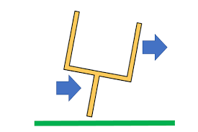
VESTING – WHY IS VESTING IMPORTANT?
PROTECTION FOR APPLICANTS
PREDICTABILITY
CERTAINTY
Notes:
The purpose of vesting is to protect the applicant’s rights by providing certainty for development rules as well as protecting them from facing a regulation that may change at the City, State of Federal level that could affect the project. This prevents cities from “moving the goalposts” mid-way through a project. Protections from changes in regulations are favored by the development community because this provides a more predictable review and certainty for the applicant.

Slide 14
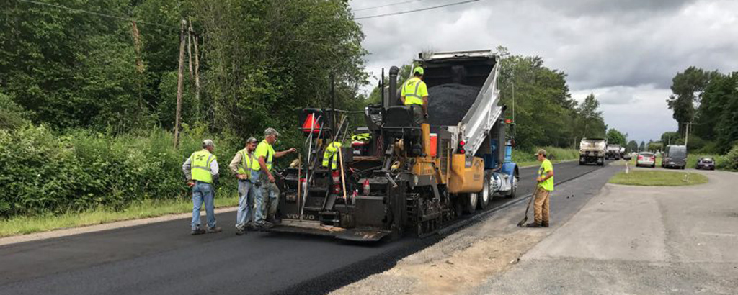
VESTING – WHY IS VESTING IMPORTANT?
PROTECTION FOR THE CITY
Notes:
Vesting is also important to the City in terms of establishing a set time frame for development. Without this timeframe, applicants may seek to use dated codes to avoid upgrading infrastructure or making the appropriate improvements for the project. The City is required by law to review completed development proposals alongside the development codes that are in place. The City cannot deny a development if it conforms with the zoning regulations and development standards.

Slide 15
VESTING - SUMMARY

