Slide 1

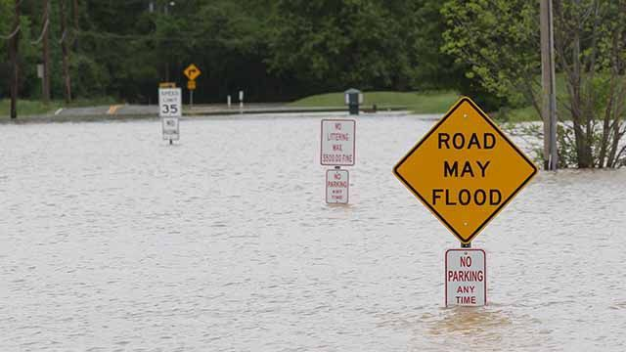
2020 Flood Preparation

Slide 2
Agenda
City of Ferndale
2020-2021 Weather Outlook
Flood-Related Projects
COF Flood Prep
Ferndale Flood Hot Spots

Slide 3
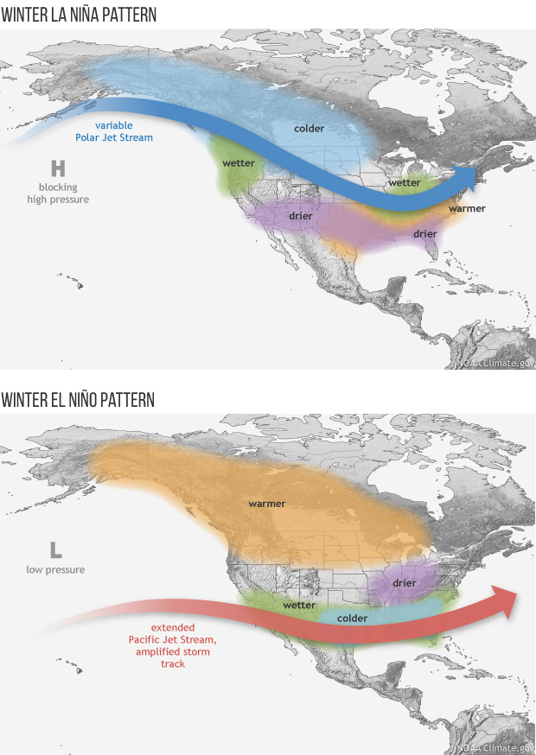
2020-2020 Predictions
National Weather Service Climate Prediction Center has issued a La Niña Advisory
La Niña conditions are present and are likely to continue through the Northern Hemisphere winter 2020-2021 (~85% chance) and into Spring 2021 (~60% chance)
Typically cooler, wetter winter in the Pacific Northwest

Slide 4
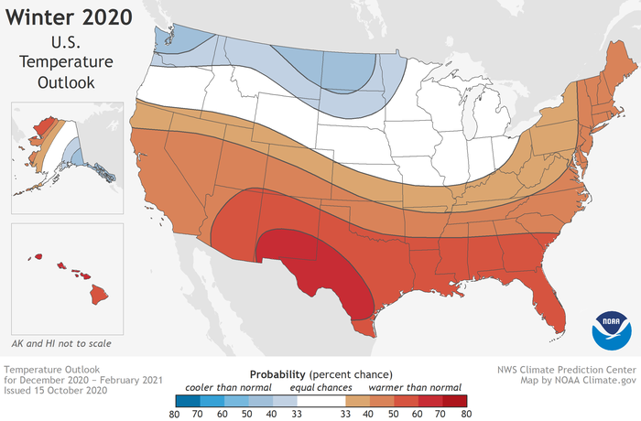
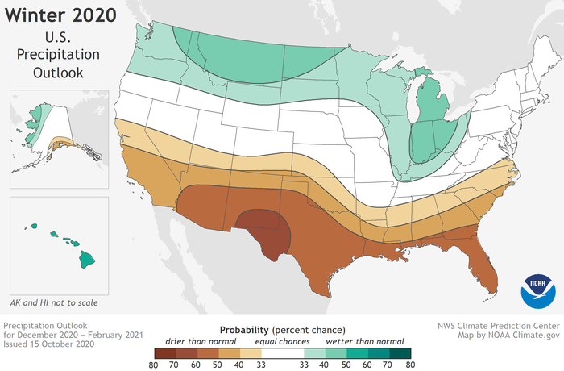
2020-2020 Predictions

Slide 5
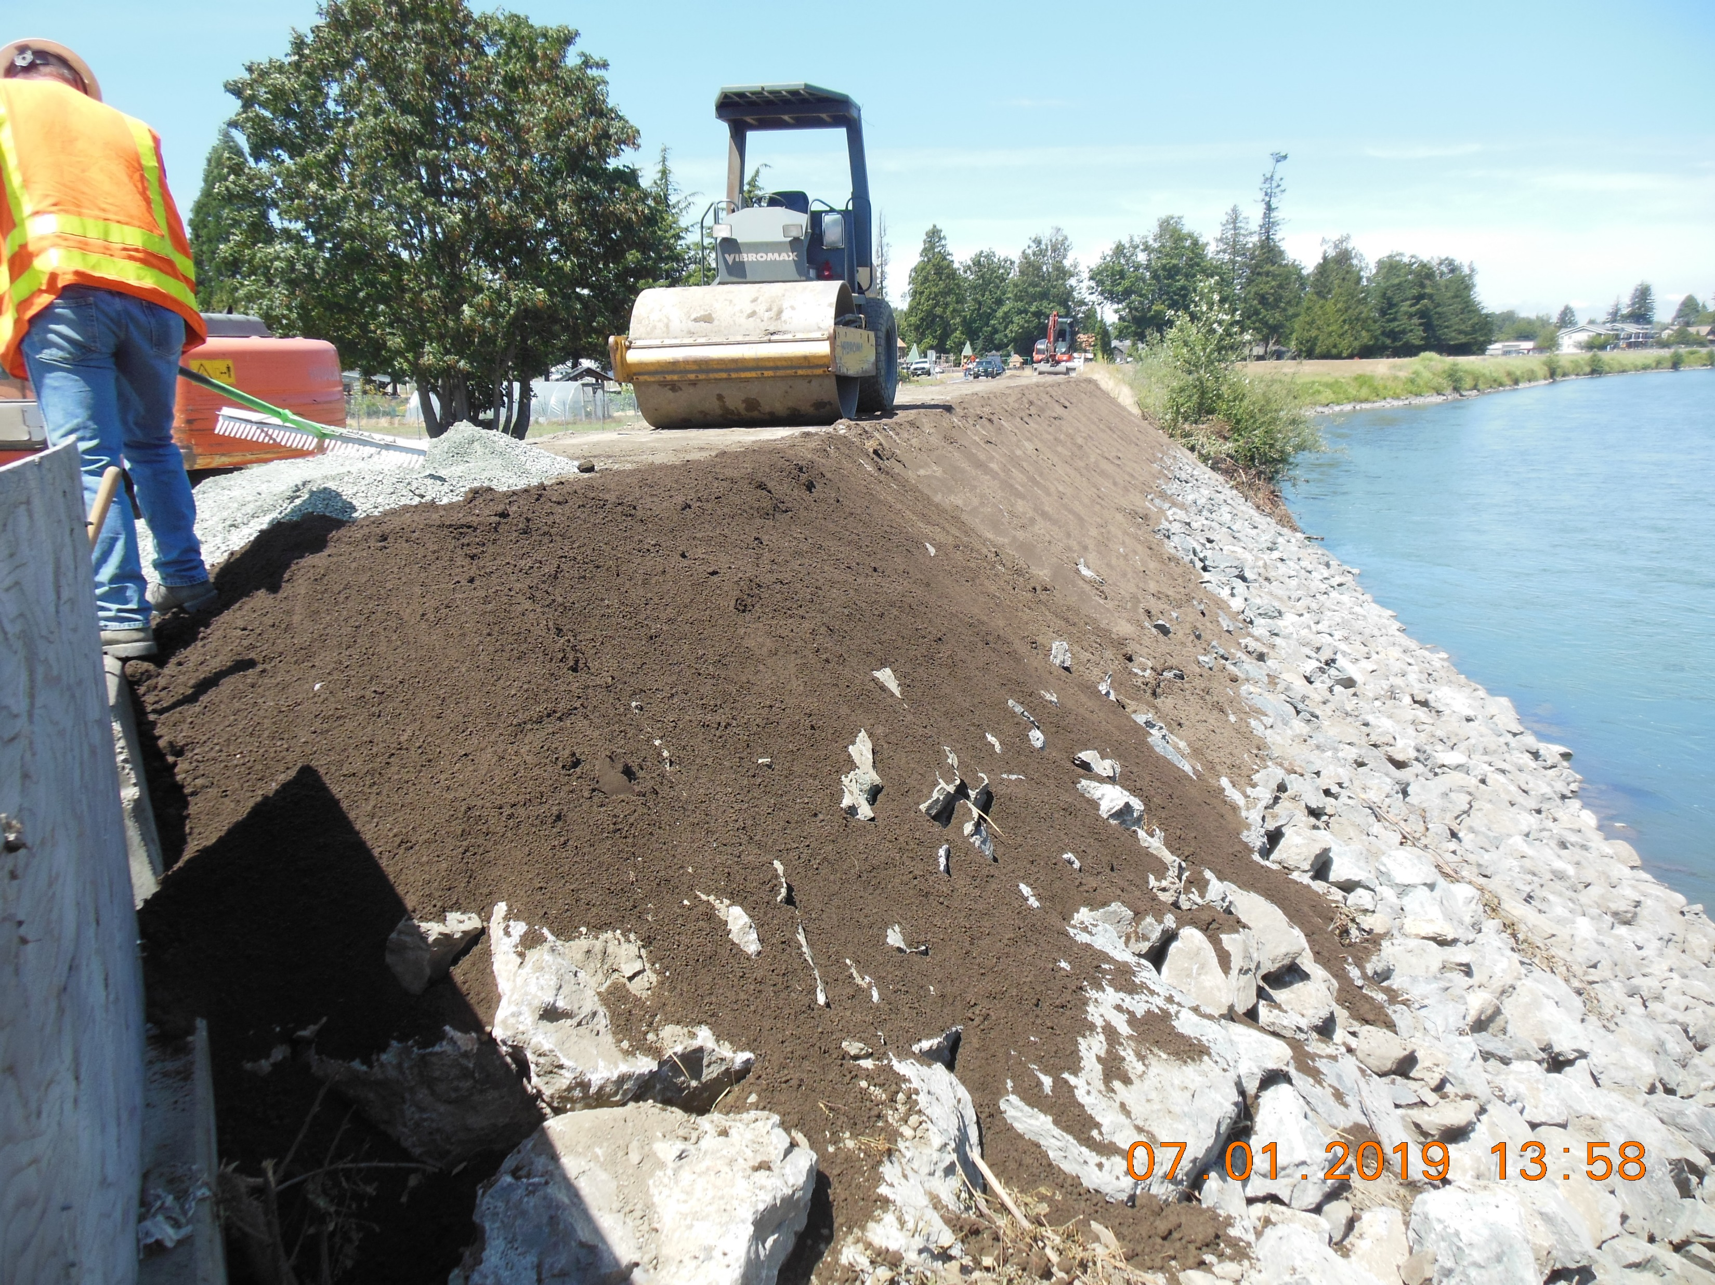
Flood Projects
2019 Levee Repairs

Slide 6
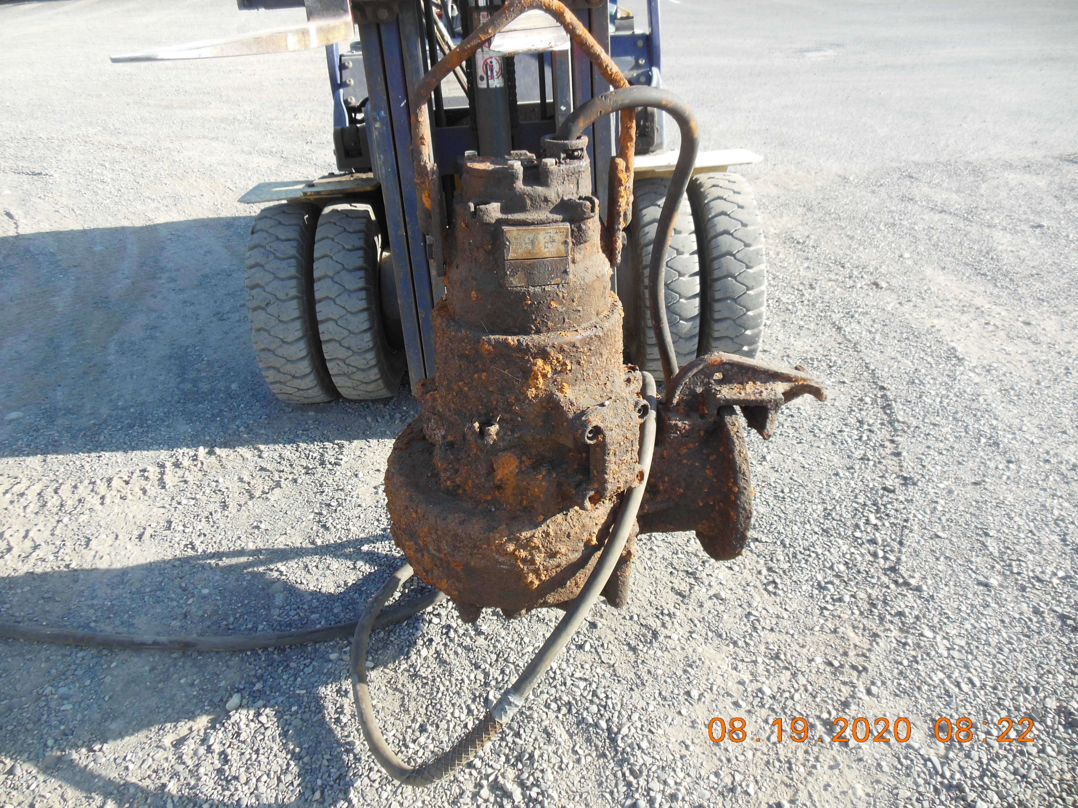
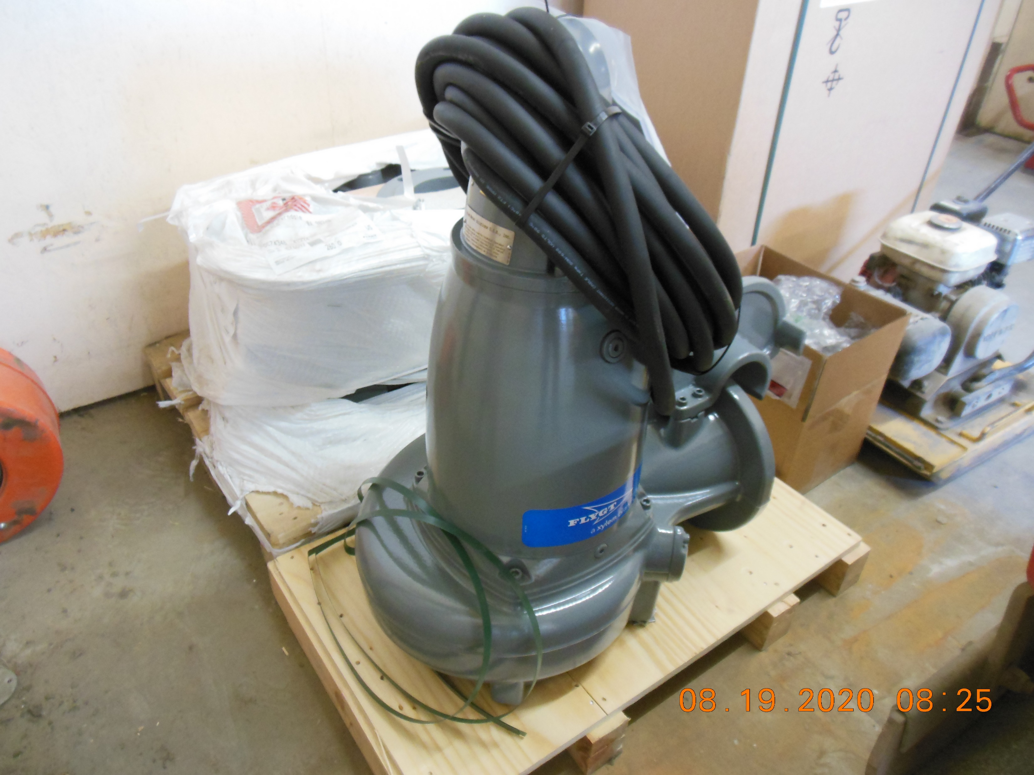
Flood Projects
2020 Pump Station 8 Pump Replacement

Slide 7
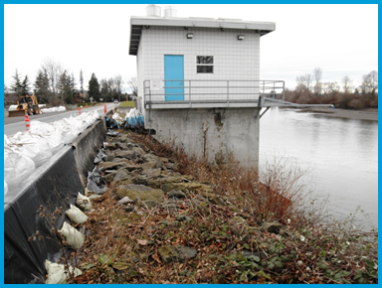
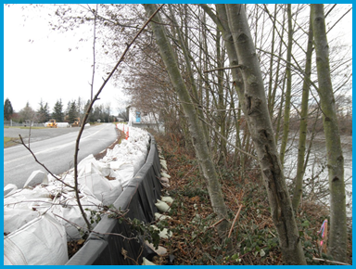
SWIF Progress
Whatcom County River and Flood administering a Floodplains by Design grant for design of levee improvements to address deficiencies, flood protection, riparian and fish habitat, and recreational opportunities.
      *System Wide Improvement Framework

Slide 8
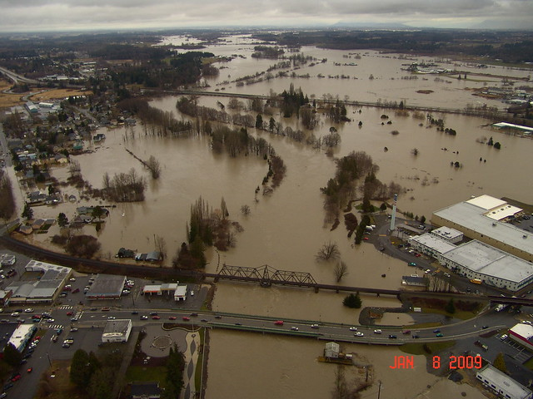
Flood Event Prep

Slide 9
Flood Prep Checklist
Communication:
Radios in good repair
Who has / needs radios
Materials:
Sand and pit run stock; sufficient
Shovels
Sandbags
Signs and barricades; sufficient
Volunteers:
Where to report
What do we need from them
Bag fill station set up
Front line bagging?
Personnel:
Phone calls to city hall
EOC staff
Front lines
FEMA data tracking documentation
Safety Equipment:
Hard hats
Safety vests
Gloves
Life jackets
Flashlights / spot lights
Hot Spots
Press Release Information:
Who is in charge of updates
Detours
Roads closed
Emergency Shelter
Forecast / Information web sites
Volunteers

Slide 10
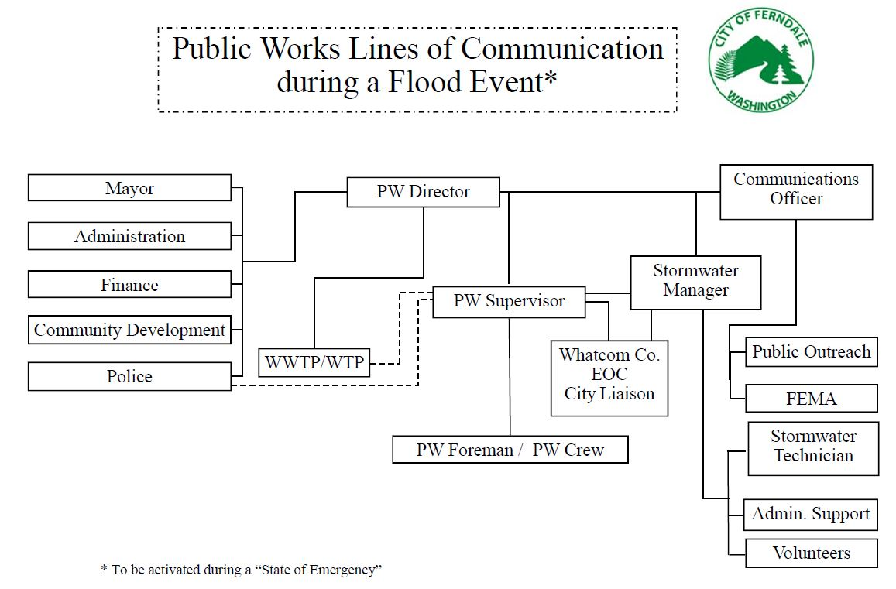
Flood Operations

Slide 11
Flood Operations
Flood Event Assignments for City Staff
Public Works Director
Oversight of Public Works efforts during the Flood Event
Communicates directly with Administration, PW Supervisor, and Stormwater Manager
PW Supervisor
Supervises Front Line, Coordinates Flood Fight
Communicates directly PW Director, Stormwater Manager, EOC, and PW Foreman & Crew
PW Foreman
Front line flood fight and hot spot monitoring
Communicates directly with PW Supervisor and Crew
PW Crew
Front line flood fight and hot spot monitoring; places sand bags and road signs
Communicates directly with PW Supervisor and PW Foreman

Slide 12
Flood Operations
Flood Event Assignments for City Staff
Stormwater Manager
Coordinates Stormwater Technician, Administration Support, and Volunteers
Communicates directly with PW Director, PW Supervisor, and PR
Emergency Operations Center (EOC) Liaison
Represents the City of Ferndale at the Whatcom County EOC in Bellingham
Gathers information from entities at EOC and relays to City of Ferndale; Presents updates from City of Ferndale and request materials if needed
Communicates directly with PW Supervisor
Backup Public Works Crew
Assists Public Works crew as necessary
  Fills and places sand bags, places road signs
  Communicates directly with PW Foreman and PW Supervisor

Slide 13
Flood Operations
Flood Event Assignments for City Staff
FEMA Data Gatherer
Ensures the City has proper documentation as required by FEMA
Takes pictures and gathers specific data
Communicates directly with Stormwater Manager
Communications Officer
Coordinates Communications, Public Relations, FEMA documentation Develops press releases, email correspondence and updates to the City’s website and reports to the Ferndale Record Journal
Communicates directly with Stormwater Manager, Public, and Staff
City Hall Phone Operator
Answers questions and relays information to and from Ferndale citizens who call City Hall. Reads from “Flood FAQ” Document.
Tracks donations of materials and time on “Donations” spreadsheet
Communicates directly with Stormwater Manager and Public

Slide 14
Flood Operations
Flood Event Assignments for City Staff
Volunteer Sign-Up Coordinator
Serves as “gate keeper” at the City Hall for volunteers. Ensures that each volunteer is signed in and accounted for
Tracks volunteers and signatures on the “Volunteer Inventory” Document
Communicates directly with Stormwater Manager and Volunteers
Sandbag Fill Station Supply Monitor
Ensures the sandbag fill station located behind City Hall is full stocked and operating smoothly
Contacts Stormwater Manager if supplies are running low
Communicates directly with Stormwater Manager and Public

Slide 15
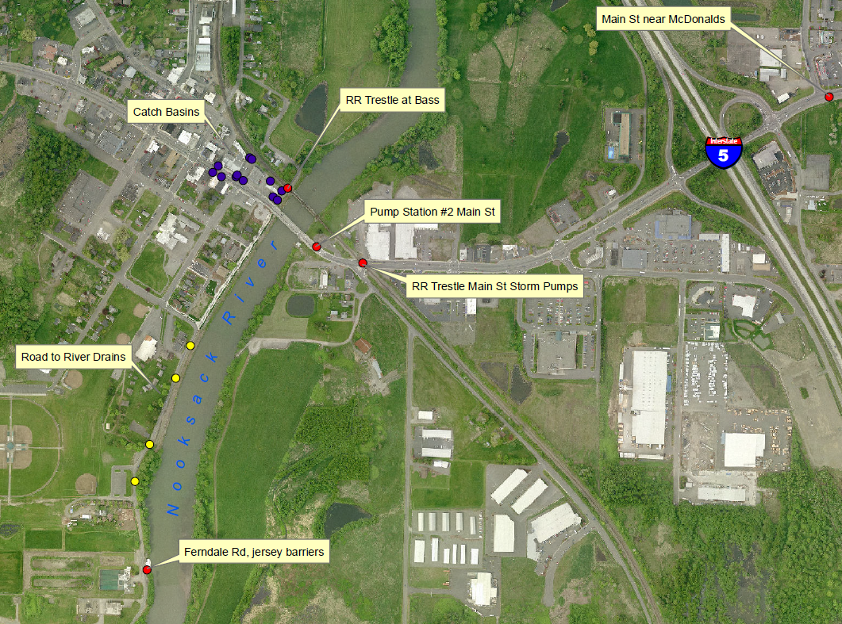

Flood Event Hot Spots
(2009 Flood)

Slide 16
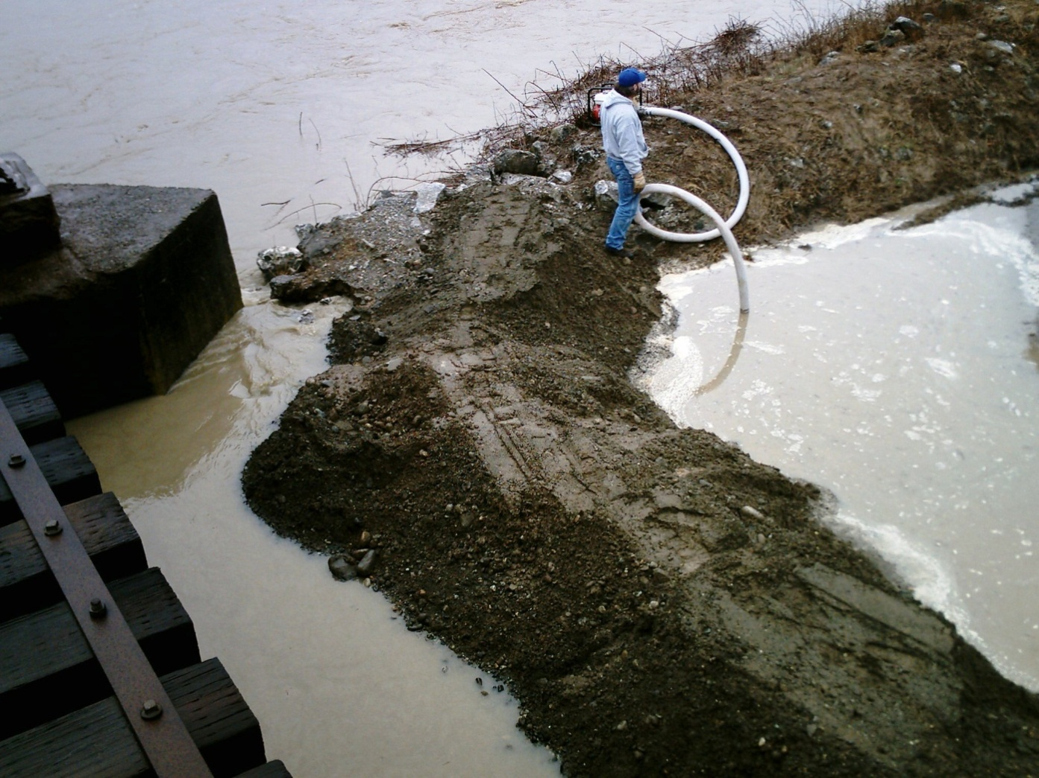
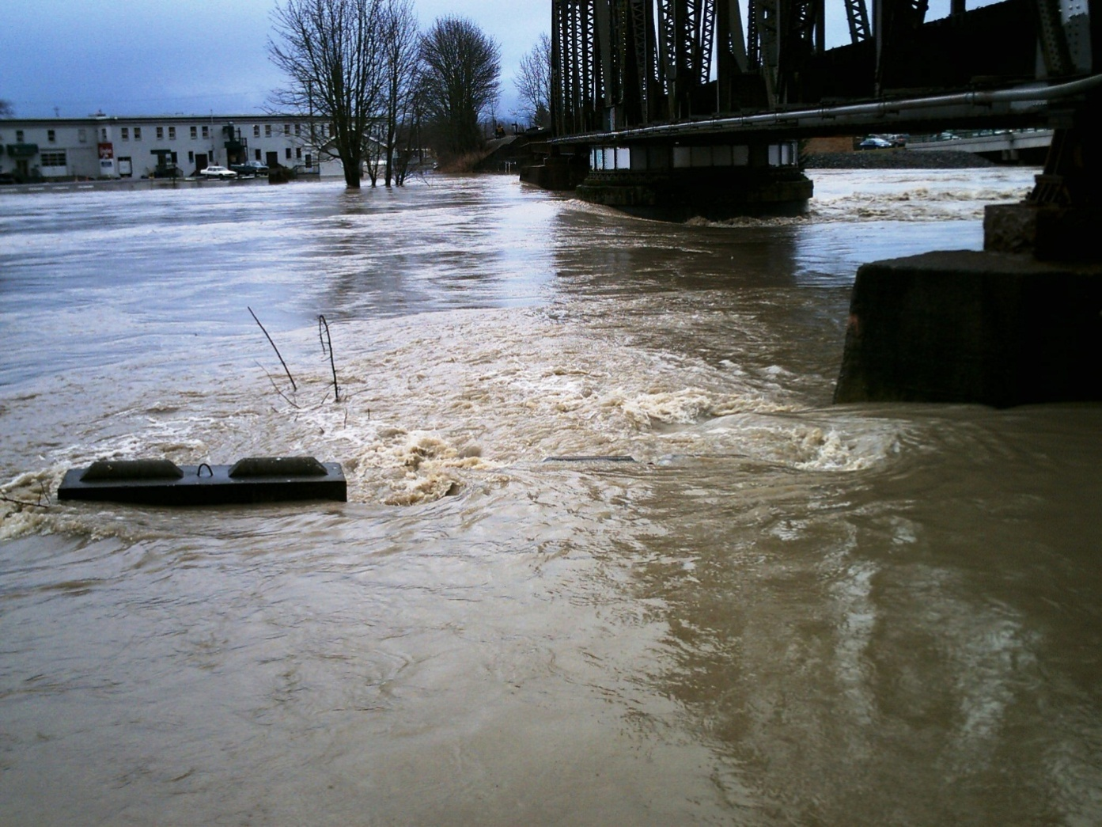
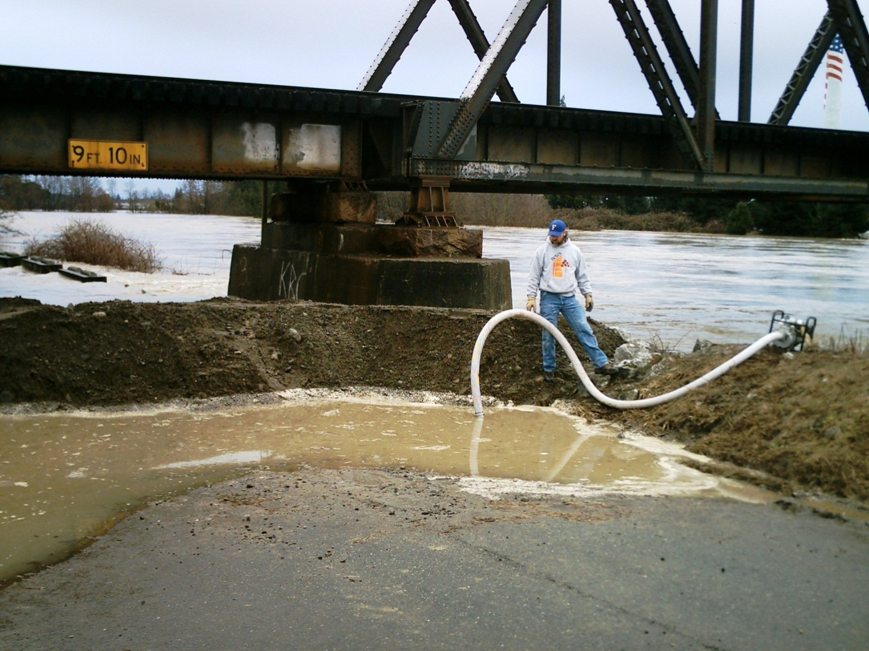
Bass Street, Railroad Trestle

Slide 17
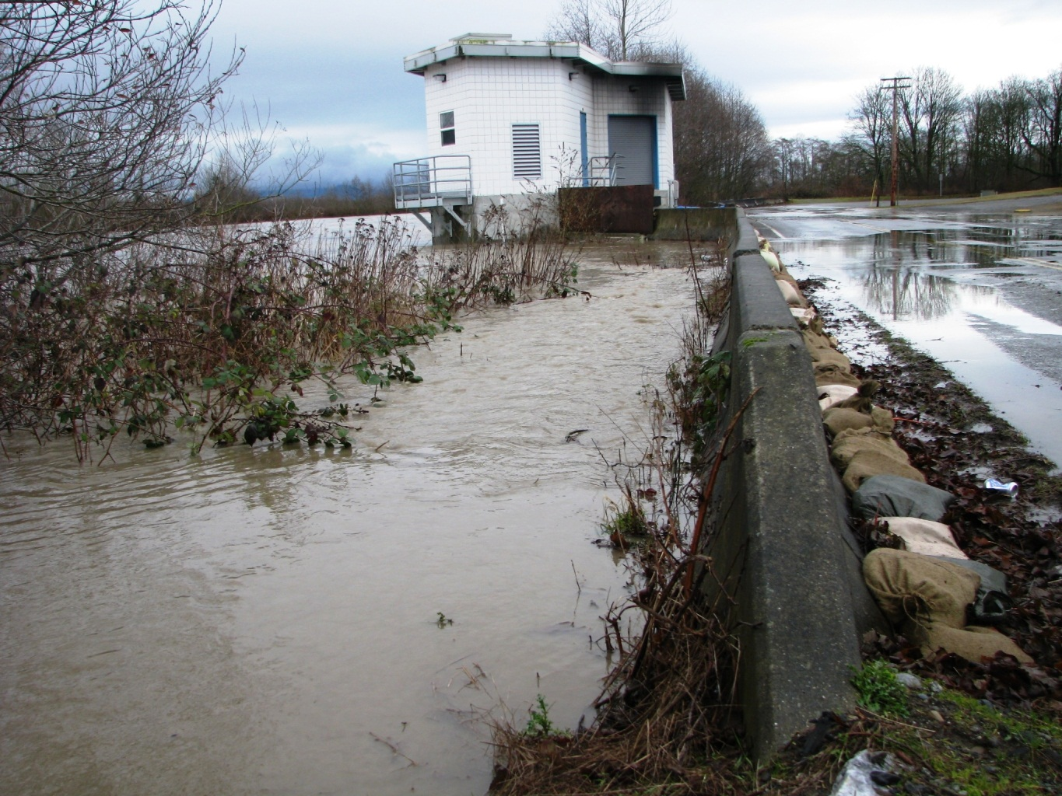
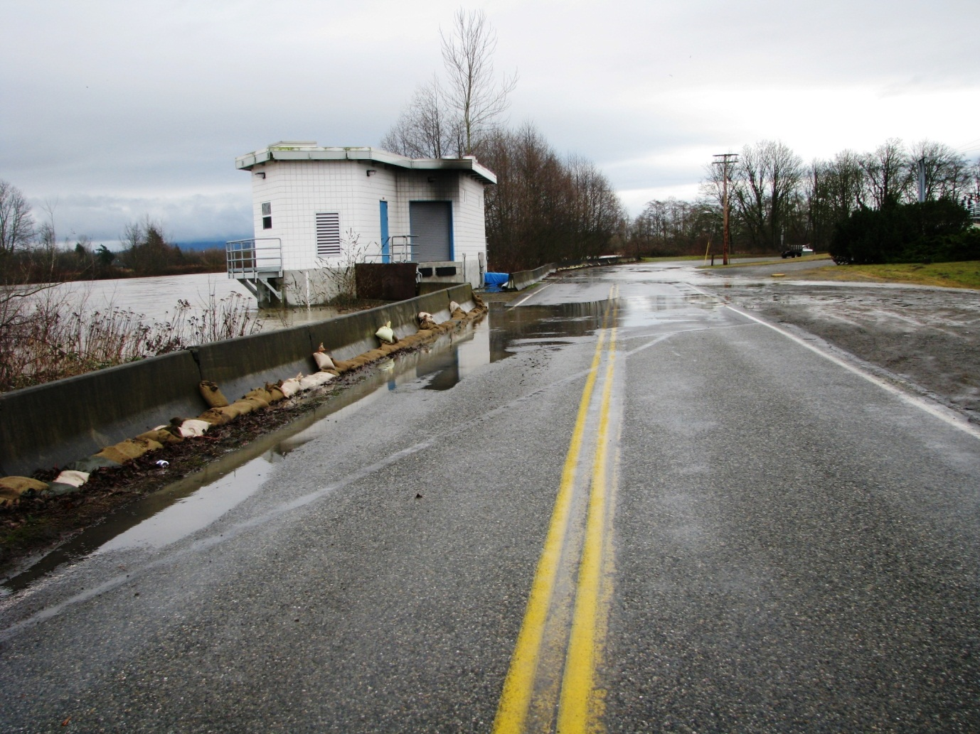
Ferndale Road, jersey barriers

Slide 18
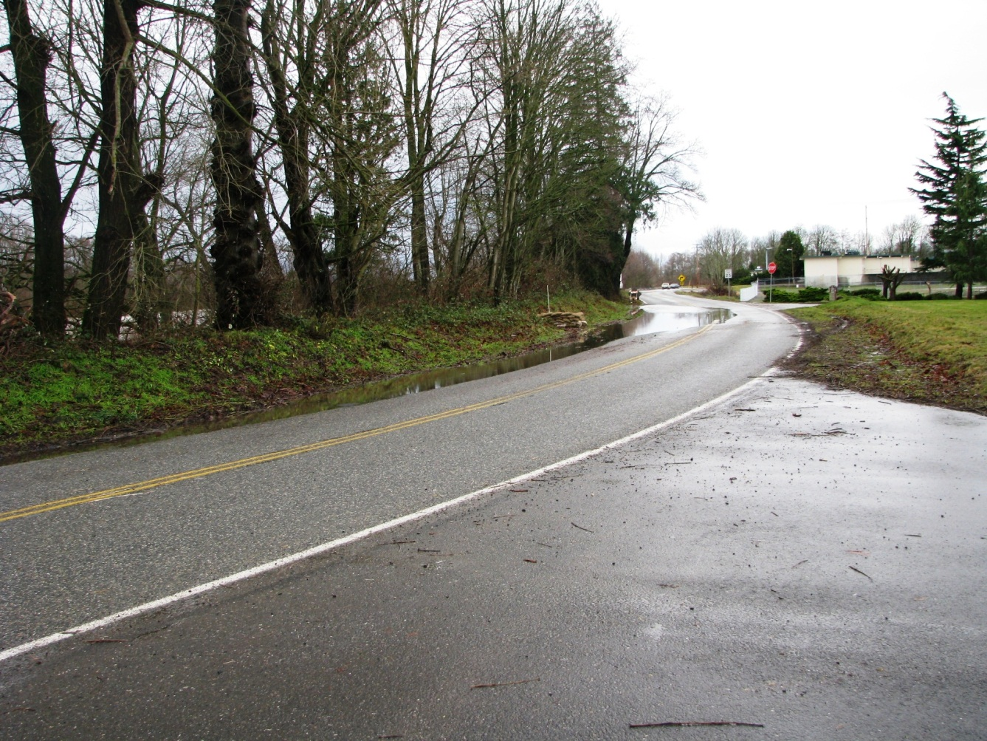
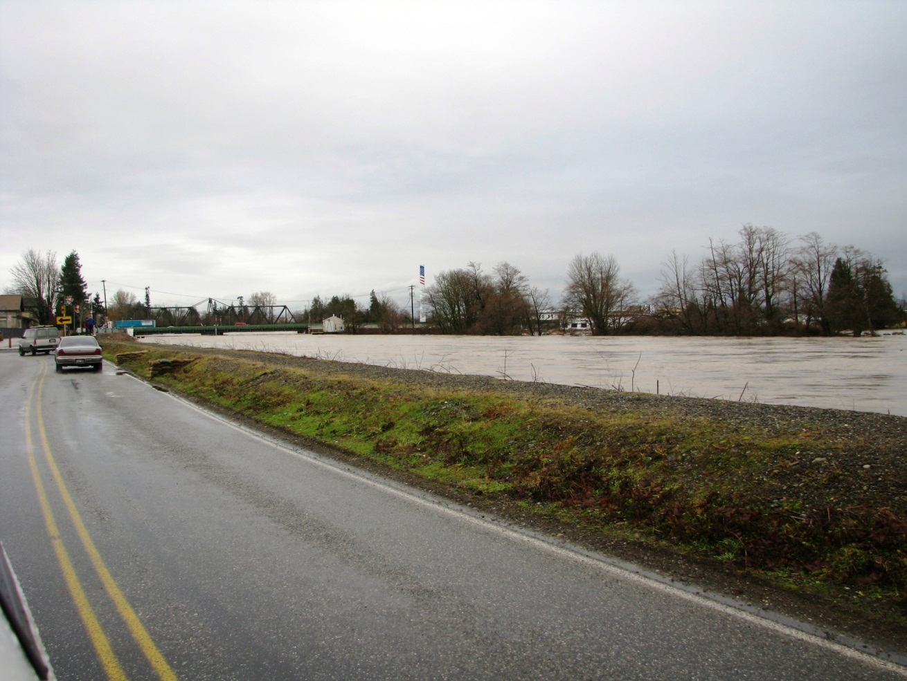
Ferndale Road, chimneys

Slide 19
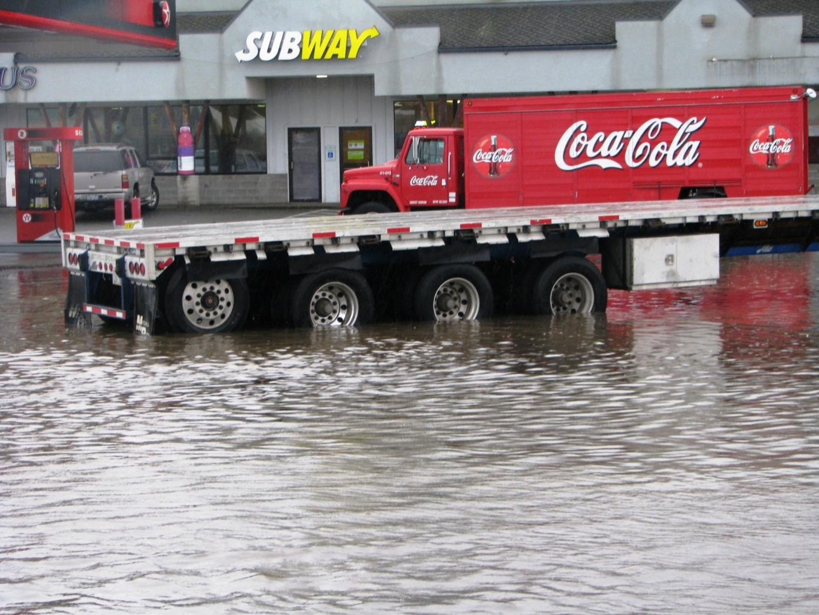
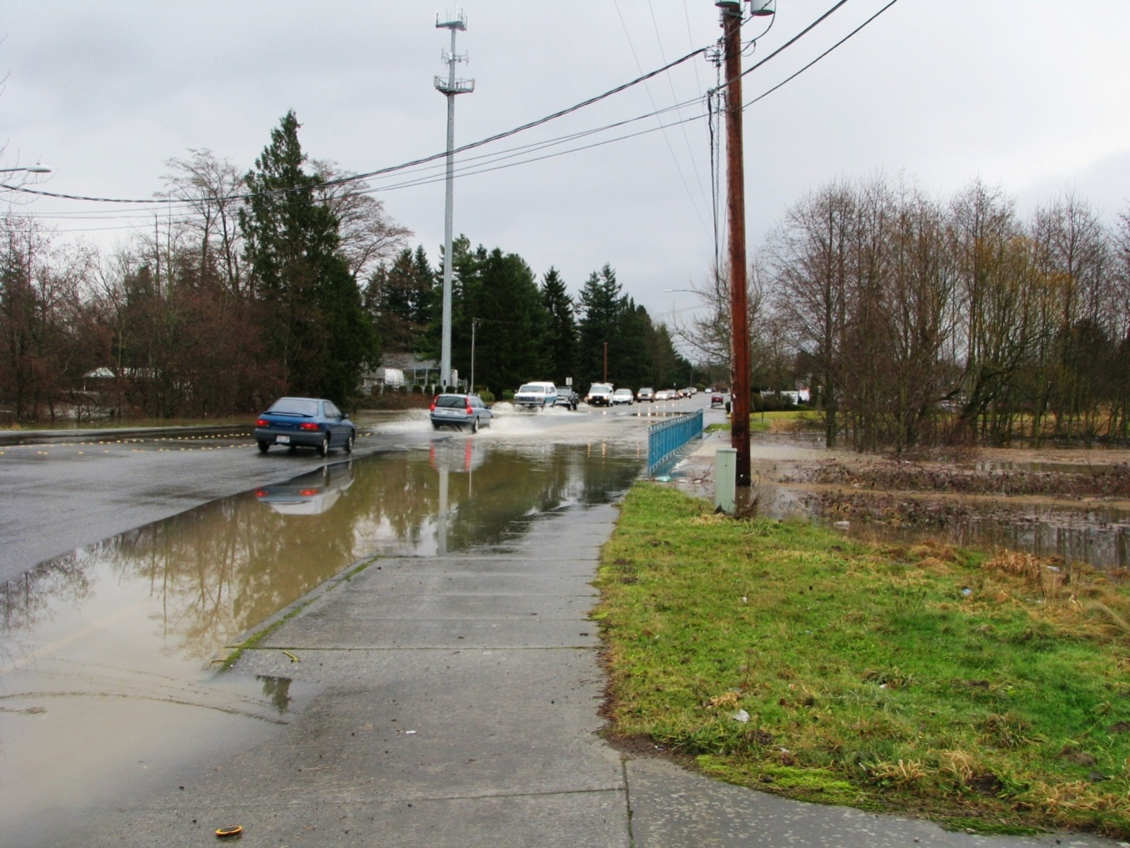
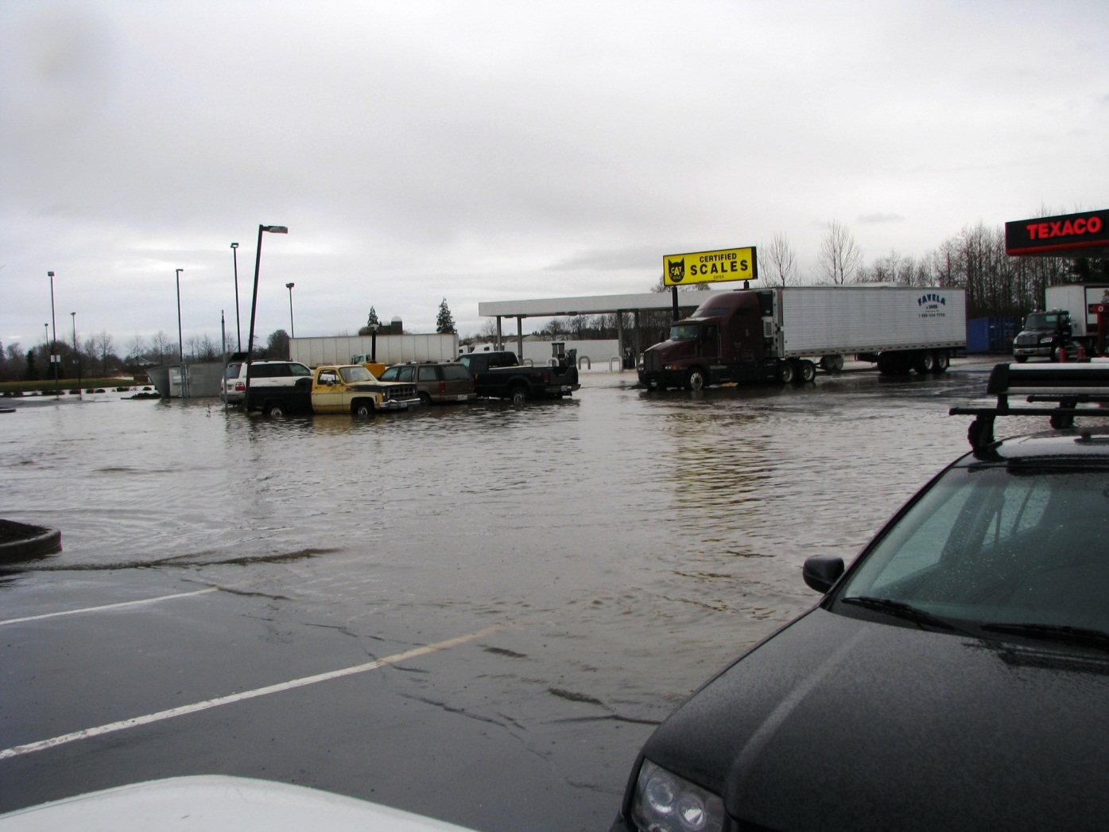
Main Street near McDonalds

Slide 20
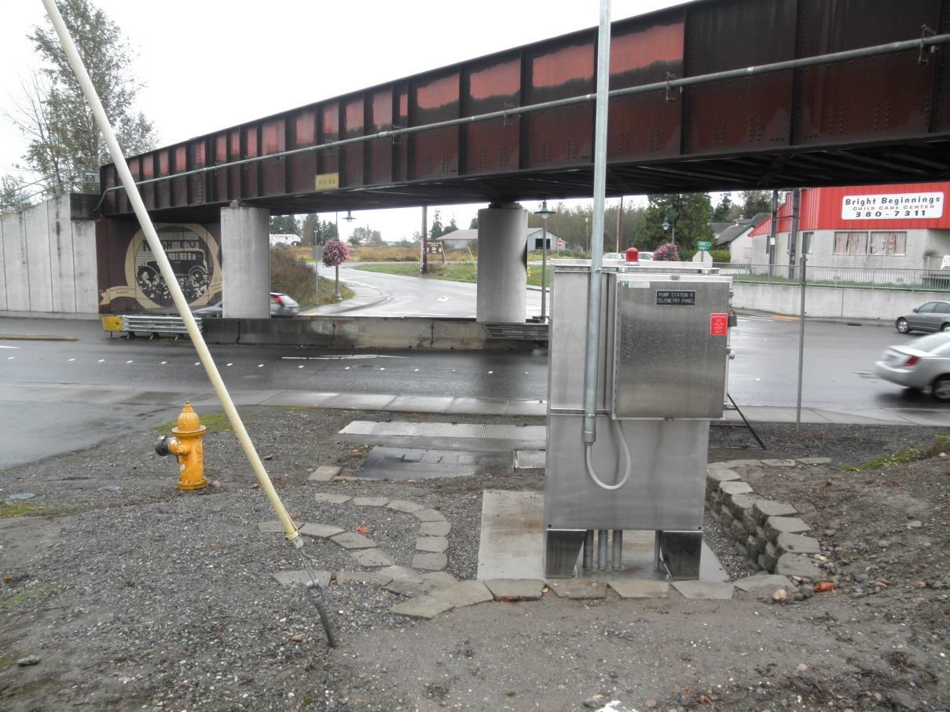
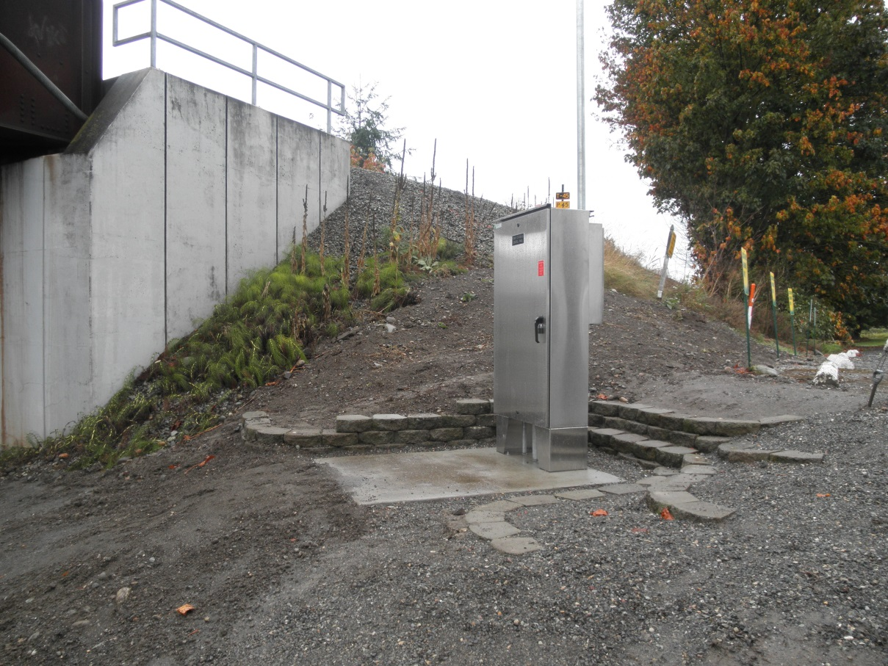
Main St./RR Trestle, storm pumps
(Pre-flood)

Slide 21
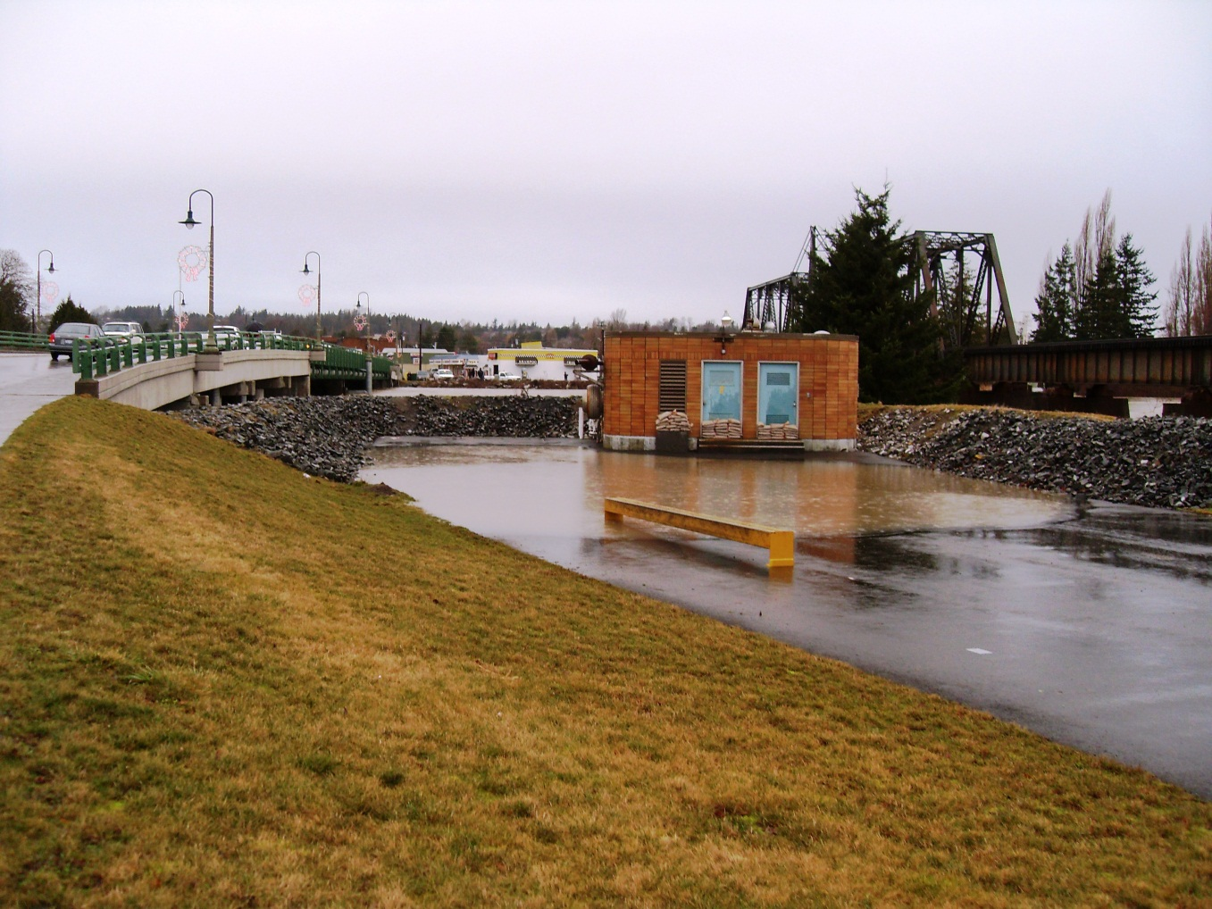
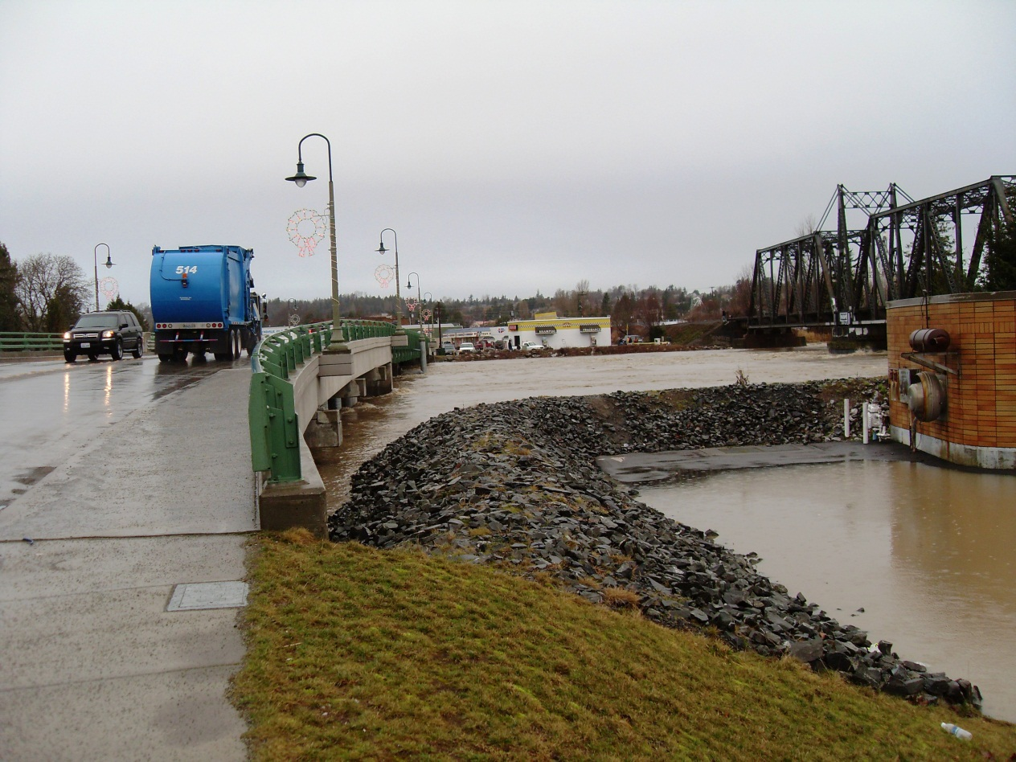
Main Street, Pump Station #2

