Slide 1
Capital Project Updates

Slide 2
Ferndale Terrace
  30% design submitted and reviewed. Permitting next.
Nordic to Scout Waterline
  100% plan review complete; BNSF permit received; bid early 2020.
Pump Station 19 Decommissioning
  90% plan review underway. Bid early 2020.
Complete Streets
  Alder ADA ramps; RRFBs on Vista and Thornton; design contract on consent agenda.
First Avenue Pedestrian
  Poles to be delivered to PSE Feb 2020. Installation estimated for Mar 2020.
THORNTON – VISTA TO MALLOY
  Qualified consultant has been selected; design contract early 2020.
THORNTON Overpass
  Preconstruction meeting today. Start date estimated early April.
Notes:
We have a number of projects we’re working on, all are at a different stage of development. Some are at the preliminary engineering stage, some are being designed now, others have just moved to construction.

Slide 3
Ferndale Terrace
  30% design submitted and reviewed. Permitting next.
Nordic to Scout Waterline
  100% plan review complete; BNSF permit received; bid early 2020.
Pump Station 19 Decommissioning
  90% plan review underway. Bid early 2020.
Complete Streets
  Alder ADA ramps; RRFBs on Vista and Thornton; design contract on consent agenda.
First Avenue Pedestrian
  Poles to be delivered to PSE Feb 2020. Installation estimated for Mar 2020.
THORNTON – VISTA TO MALLOY
  Qualified consultant has been selected; design contract early 2020.
THORNTON Overpass
  Preconstruction meeting today. Start date estimated early April.
Notes:
Precon:
Contractor – Project Manager, Estimator, Admin, Project Engineer, Surveyor/GPS
City Staff – PWD, Project Manager, Inspector, Admin, PW Supervisor
City’s Consultants – Civil Engineer, Bridge Engineer, Geotechnical Engineer, Surveyor, Bridge PM, Materials Testing Company
Others – Comcast, Frontier & Cascade Natural Gas
Discuss: Relationship, Schedule, Impacted parties (utilities, including the City’s), Subcontractors, Submittals and other Requirements (RAMs, QPLs, TCPs, Labor and Equipment Rates, shop and working drawings, NPDES, SPCC, Inadvertent Discovery Plan, RFI’s, Certified Payroll, LS breakdowns, & more), Traffic Control & Site Safety (including access to adjacent properties), General Construction Discussion (hours of work, force account, payments, staging of equipment, etc), Potential Issues or Changes.
Partnering versus adversarial

Slide 4
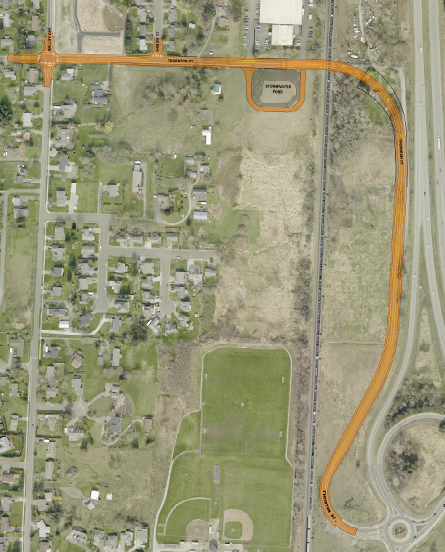
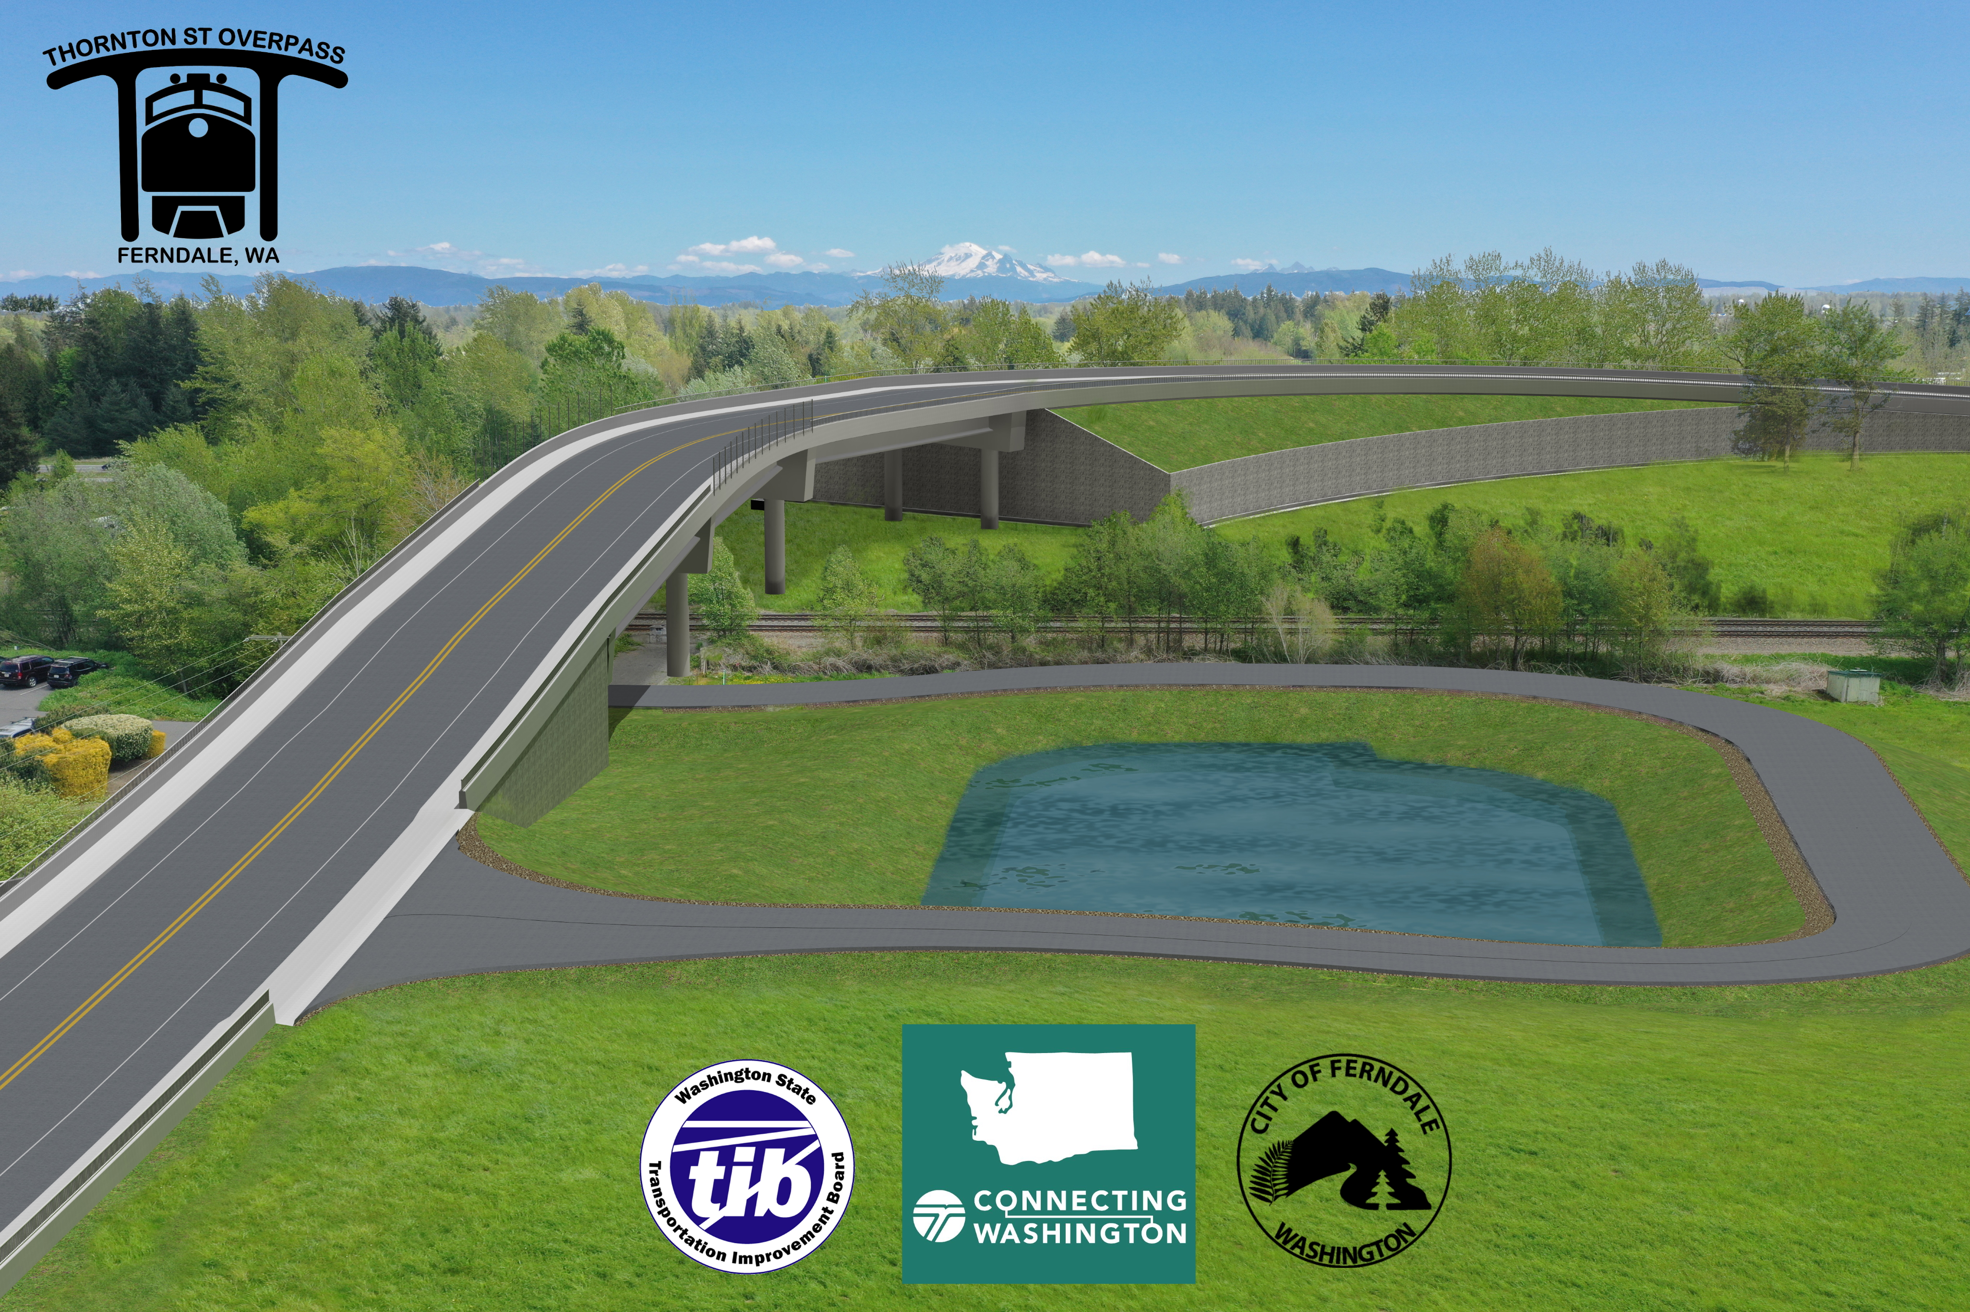
DRAFT
Thornton Overpass Schedule
Early April 2020
  Mobilization, Traffic Control, Erosion Control, Survey
Late April 2020
  House Demolition, Start of Sanitary Sewer Work
Mid-Late May 2020
  Start of Watermain Installation, Joint Utility Trench, and Prepare for Preload
Early June 2020
  Prepare for Preload, and Start Wall Construction (West)
Late June 2020
  Start Wall Construction (East).
July 2020
  Settlement Period Begins - This may take through December 2021

Slide 5
DRAFT
Thornton Overpass Schedule
Early April 2020
  Mobilization, Traffic Control, Erosion Control, Survey
Late April 2020
  House Demolition, Start of Sanitary Sewer Work
Mid-Late May 2020
  Start of Watermain Installation, Joint Utility Trench, and Prepare for Preload
Early June 2020
  Prepare for Preload, and Start Wall Construction (West)
Late June 2020
  Start Wall Construction (East).
July 2020
  Settlement Period Begins - This may take through December 2021

Slide 6
DRAFT
Thornton Overpass Schedule
Early April 2020
  Mobilization, Traffic Control, Erosion Control, Survey
Late April 2020
  House Demolition, Start of Sanitary Sewer Work
Mid-Late May 2020
  Start of Watermain Installation, Joint Utility Trench, and Prepare for Preload
Early June 2020
  Prepare for Preload, and Start Wall Construction (West)
Late June 2020
  Start Wall Construction (East).
July 2020
  Settlement Period Begins - This may take through December 2021

Slide 7
DRAFT
Thornton Overpass Schedule
Early April 2020
  Mobilization, Traffic Control, Erosion Control, Survey
Late April 2020
  House Demolition, Start of Sanitary Sewer Work
Mid-Late May 2020
  Start of Watermain Installation, Joint Utility Trench, and Prepare for Preload
Early June 2020
  Prepare for Preload, and Start Wall Construction (West)
Late June 2020
  Start Wall Construction (East).
July 2020
  Settlement Period Begins - This may take through December 2021

Slide 8
DRAFT
Thornton Overpass Schedule
Early April 2020
  Mobilization, Traffic Control, Erosion Control, Survey
Late April 2020
  House Demolition, Start of Sanitary Sewer Work
Mid-Late May 2020
  Start of Watermain Installation, Joint Utility Trench, and Prepare for Preload
Early June 2020
  Prepare for Preload, and Start Wall Construction (West)
Late June 2020
  Start Wall Construction (East).
July 2020
  Settlement Period Begins - This may take through December 2021

Slide 9
DRAFT
Thornton Overpass Schedule
Early April 2020
  Mobilization, Traffic Control, Erosion Control, Survey
Late April 2020
  House Demolition, Start of Sanitary Sewer Work
Mid-Late May 2020
  Start of Watermain Installation, Joint Utility Trench, and Prepare for Preload
Early June 2020
  Prepare for Preload, and Start Wall Construction (West)
Late June 2020
  Start Wall Construction (East).
July 2020
  Settlement Period Begins - This may take through December 2021

Slide 10

DRAFT
Thornton Overpass Schedule
Early April 2020
  Mobilization, Traffic Control, Erosion Control, Survey
Late April 2020
  House Demolition, Start of Sanitary Sewer Work
Mid-Late May 2020
  Start of Watermain Installation, Joint Utility Trench, and Prepare for Preload
Early June 2020
  Prepare for Preload, and Start Wall Construction (West)
Late June 2020
  Start Wall Construction (East).
July 2020
  Settlement Period Begins - This may take through December 2021
AND NOW WE WAIT

Slide 11
Capital Project Updates
QUESTIONS
???

Slide 12
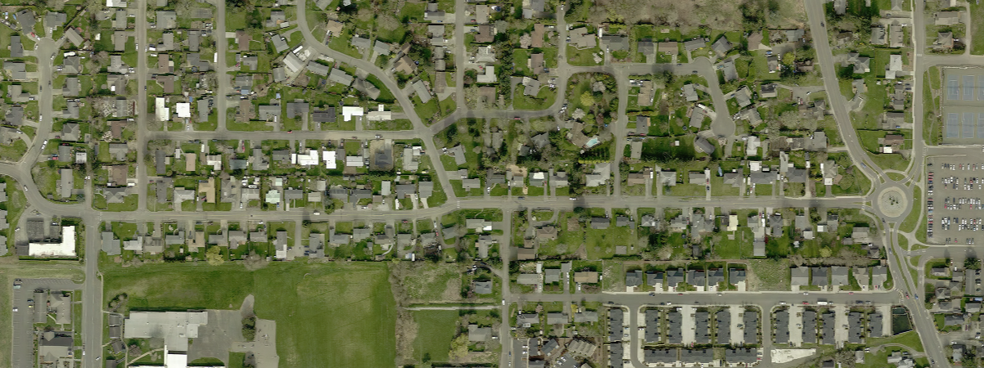
Ferndale Terrace
Vista
Hendrickson
Notes:
In the design phase, Ferndale Terrace will include a full reconstruction of the roadway and utility systems, including sewer, water and stormwater. We received a $250K grant from the Department of Ecology for the planning and design portion of this project.

Slide 13
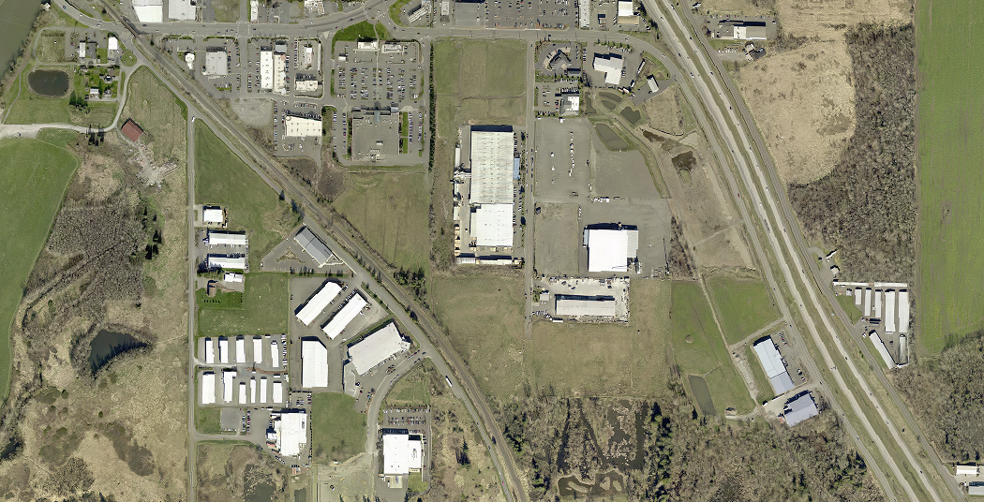
Nordic to Scout Waterline
Nordic
Hovander
Scout
Notes:
This project will install a 12” water main between Hovander and Nordic Way at Scout Place, including bore beneath the BNSF railroad tracks. A operational deficiency is being addressed by creating a loop in the water system where none exists presently. The loops (interconnectivity between lines) allows for more stable pressure and reliability in case of water main breaks/outages. CN cost estimate is $390K, all City money.

Slide 14
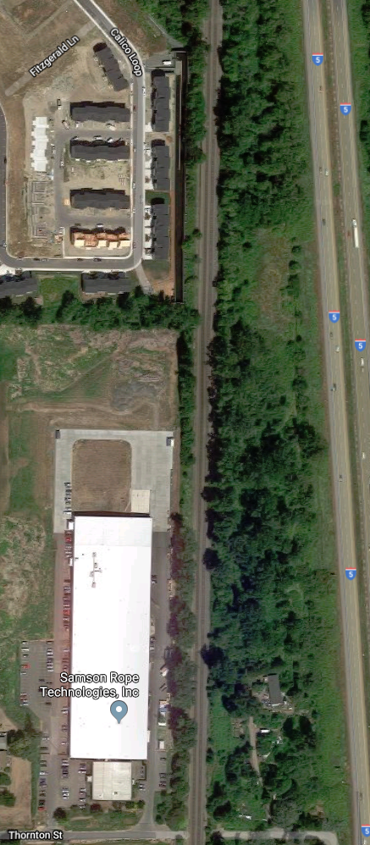
Pump
Station 19
Decommissioning
Notes:
Sewage from Malloy Village and a majority of homes being constructed now at Malloy Heights flow through this pump station. Current facility is undersized for full build out of homes. Project will decommission the pump station and install a new gravity line to the Thornton interceptor. Work includes upgrading and replacing an existing watermain at Samson Rope. CN Cost Estimate is: $630K

Slide 15
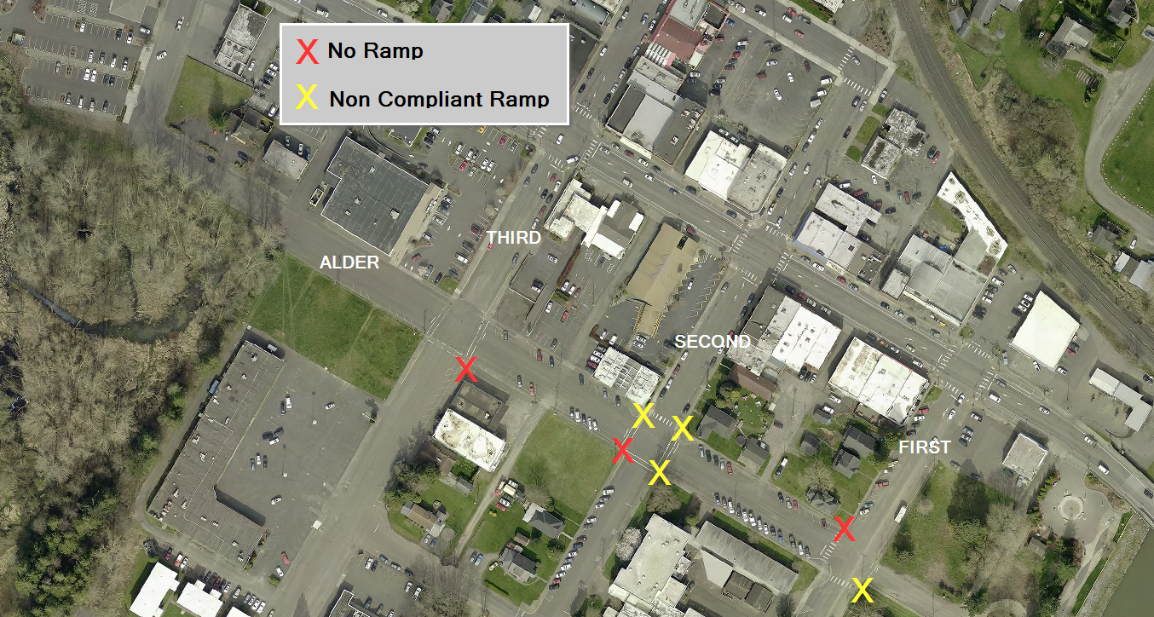
Complete Streets
Lower Downtown ADA Improvements $50K
Notes:
A TIB grant, the City received funding to improve pedestrian facilities in several areas. Alder street was awarded $50K for upgrading currently non-ADA compliant ramps shown at the yellow X’s.

Slide 16
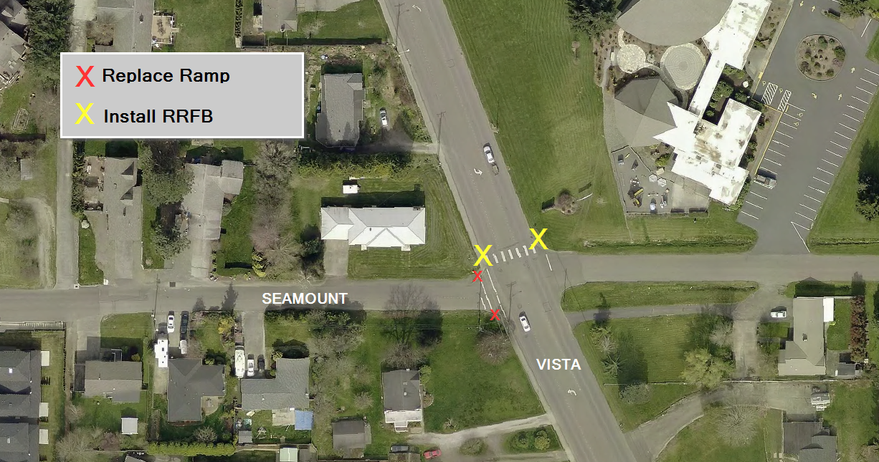
Complete Streets
VISTA DRIVE ADA Improvements $100K
Notes:
$100K to install a RRFB Rectangular Rapid Flashing Beacon at Vista and Seamount.

Slide 17
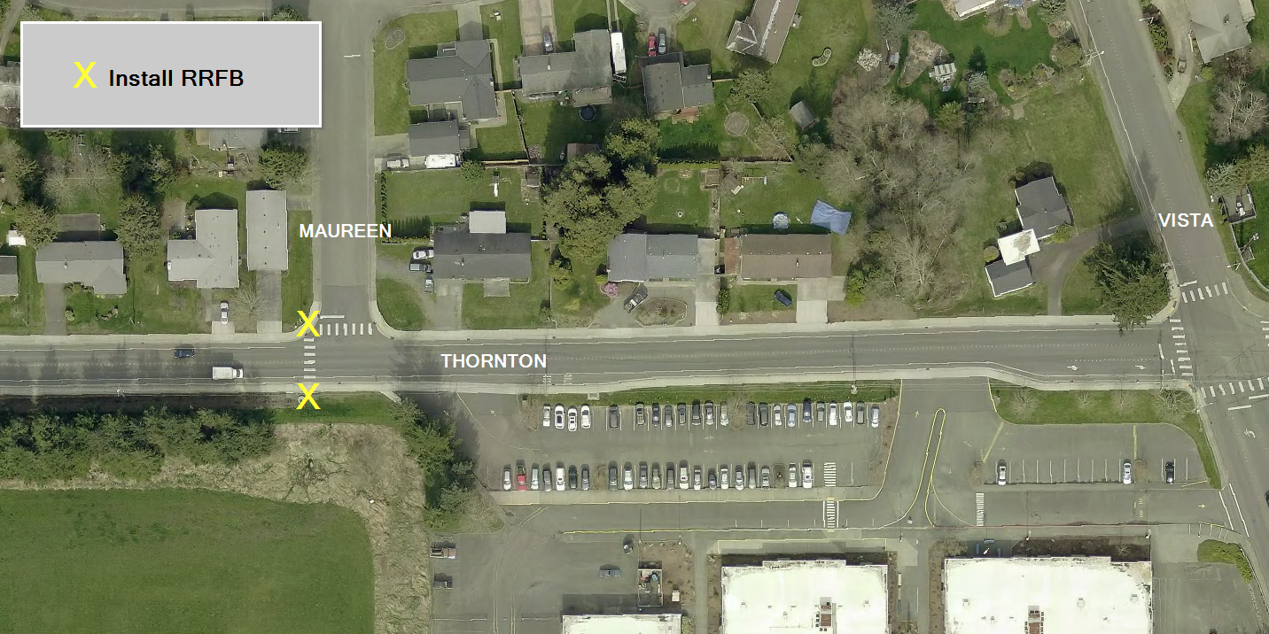
Complete Streets
Thornton and Maureen Crosswalk $50K
Notes:
Another $50K was provided to install an RRFB on Thornton at Maureen at an existing crosswalk near Skyline Elementary School.

Slide 18
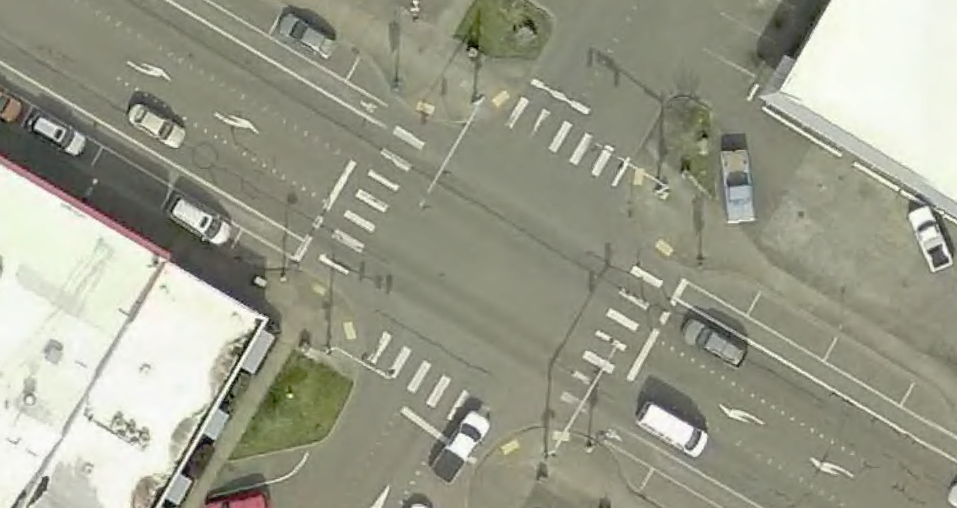
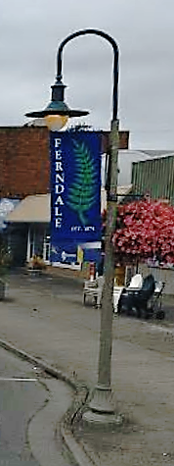
First Avenue Pedestrian Improvements
Notes:
Also a complete streets project, the City recently removed and reconfigured the crosswalk markings in this location. In order to eliminate sign blight and clutter, working with PSE to replace existing streetlights with RRFBs configured within the light itself. TIB contributes $100K.

Slide 19
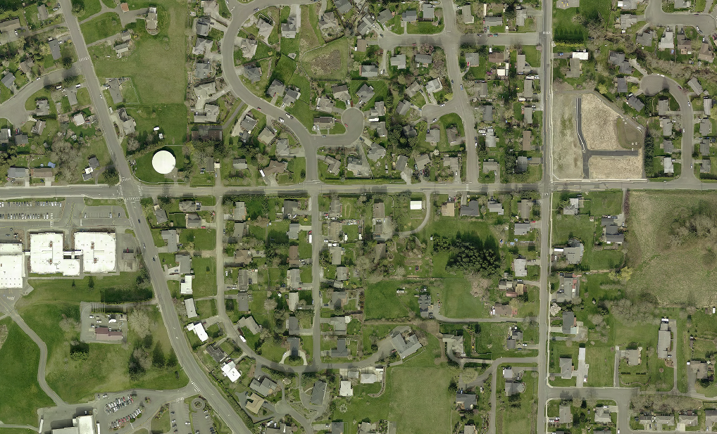
Thornton – Vista to Malloy
Vista
Thornton
Malloy
Notes:
As part of this project, upgrades will be made to the existing utilities, including storm, water and sanitary sewer systems. Sidewalks will be installed in compliance with ADA standards, with curb ramps on both sides of the road. Street lighting will be upgraded or added where needed. Fed Funding of $1,095,000 for CN

Slide 20
Thornton Overpass
Notes:
Project limits are from Malloy to Portal Way/Second Avenue Roundabout. The City received $19.167M from Connecting Washington (state Funds) in 2016. It received an additional $2.6M in 2018 from the TIB.
Current Construction contract is $15,077,000.44.
CE/CM is $1,925,320
Spent to date is: $2,173,262
Total: $19.2M

