Slide 1
$12,600,000 (WHATCOM COUNTY SHARE)
$1.9 MILLION (15%) RESERVES
$1.9 MILLION (15%) ESSENTIAL GOVERNMENT SERVICES
$1.9 MILLION (15%) FOOD, HOUSING, HUMAN SERVICES
$429,000
$5 MILLION (40%) PUBLIC HEALTH EMERGENCY RESPONSE
$250,000
RETAINED
$179,000
TO REGION
$1.9 MILLION (15%) ECONOMIC AND BUSINESS RESPONSE

Slide 2
$30,000 COMMUNITY ASSISTANCE (BUY LOCAL/UTILITIES, DIRECT GRANTS TO COMMUNITY ORGANIZATIONS)
$30,000 RESERVE (ADDITIONAL PROJECTED EXPENSES THROUGH OCTOBER 31ST)
$250,000
RETENTION
$30,000 COVID-RELATED MUNICIPAL COURT IMPROVEMENTS (NON-CONTACT SCREENING, INGRESS/EGRESS IMPROVEMENTS)
$10,000 FEMA REMAINDER (PPE, EMERGENCY RESPONSE, REPRESENTS REMAINING BALANCE OF FEMA REIMBURSEMENT)
$150,000 STAFF SALARIES (THROUGH OCTOBER 31ST, CREATES GENERAL FUND FLEXIBILITY. ESTIMATED 20% OF COSTS JUNE 1 – OCTOBER 31)

Slide 3
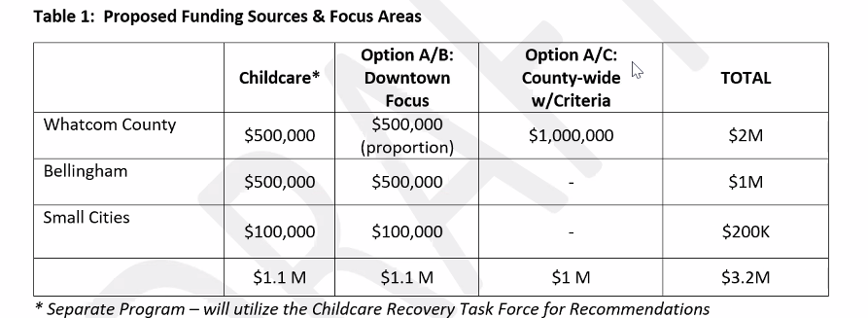
ECONOMIC AND
BUSINESS RESPONSE
FERNDALE CONTRIBUTION:
$80,000

Slide 4
THIS AND OTHER SLIDES WOULD SHOW HOW THE OTHER ~$180,000 OF OUR CONTRIBUTION WOULD GO OR COULD GO, BASED ON THE VARIOUS COUNTY BUCKETS IDENTIFIED (ESSENTIAL GOVERNMENT; FOOD, HOUSING, HUMAN SERVICES; PUBLIC HEALTH EMERGENCY – WHICH MAY BE MOSTLY UNIFIED, WHICH THE COUNTY IS PICKING UP THE TAB FOR)

