Slide 1
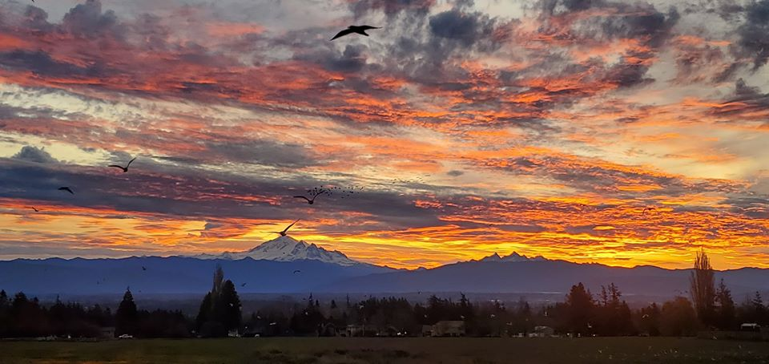
CITY OF FERNDALE
2020
FIRST QUARTER
WORK PLAN

Slide 2
THE START OF THE BEGINNING

Slide 3
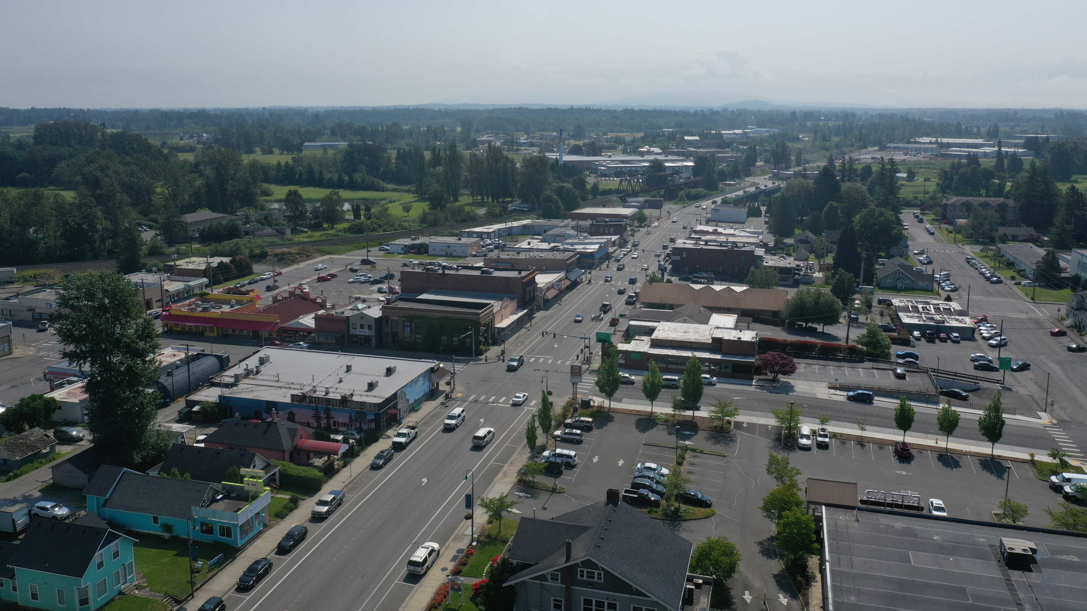
WHERE WE STAND
THORNTON STREET CONTRACT APPROVED
SEWER PLANT BIDS – FIRST QUARTER
2020 BUDGET APPROVED
UNION NEGOTATIONS COMPLETED (MOST FOR THREE YEARS)
ADMINISTRATIVE REVIEW OF CATALYST PROJECTS CONTINUES

Slide 4
WHERE WE STAND
2019
WAS A TRANSITIONAL YEAR
2020
IS EXPECTED TO BUILD ON WHAT 2019 CREATED – MUCH OF THE WORK PLAN IS PRESCRIBED BY THE BUDGET AND THE DECISIONS MADE IN 2019

Slide 5
THIS MEANS THAT THE COUNCIL CAN CONCENTRATE ON LEARNING FOR THE FIRST PART OF THE YEAR

Slide 6
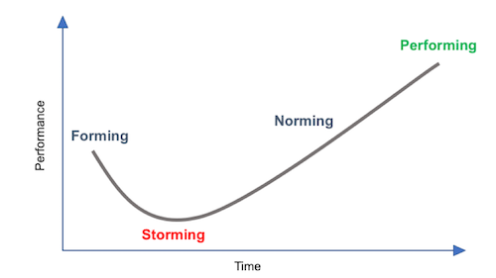
TEAM DYNAMICS (TUCKMAN MODEL)
FORMING:
HIGH DEGREE OF GUIDANCE NEEDED
INDIVIDUAL ROLES UNCLEAR
STORMING:
UNDERSTANDING HOW TEAM DECISIONS ARE MADE
PURPOSE IS CLEAR, TEAM RELATIONSHIP STILL BLURRY
NORMING:
RELATIONSHIPS UNDERSTOOD
COMMITMENT TO LEARN GOALS
BEGIN TO OPTIMIZE TEAM PROCESS
PERFORMING:
TEAM IS COMMITTED TO PERFORMING WELL
FOCUS ON BEING STRATEGIC
TEAM RUNS WELL

Slide 7
FIRST QUARTER ------------------>
COUNCIL
RETREATS
ONBOARDING
PRESENTATIONS
INTRODUCTION/
HOUSEKEEPING
GREATER DEPTH
VARIABLE
DECISION-MAKING
2021 GOALS
OPEN-ENDED
POLICYMAKING

