Slide 1

Wastewater Treatment Plant - Facilities Plan
SERP Public Participation Meeting
City of Ferndale

Slide 2
AGENDA
SERP PUBLIC MEETING
I. Project Overview
  II. Discussion of Environmental Impacts
  III. Discussion of Alternatives, Costs, and Rate Impacts
  IV. Public Comment Opportunities

Slide 3
DISCUSSION – PART I.
I. Project Overview
    Project Description
    Funding
    SERP – State Environmental Review Process

Slide 4
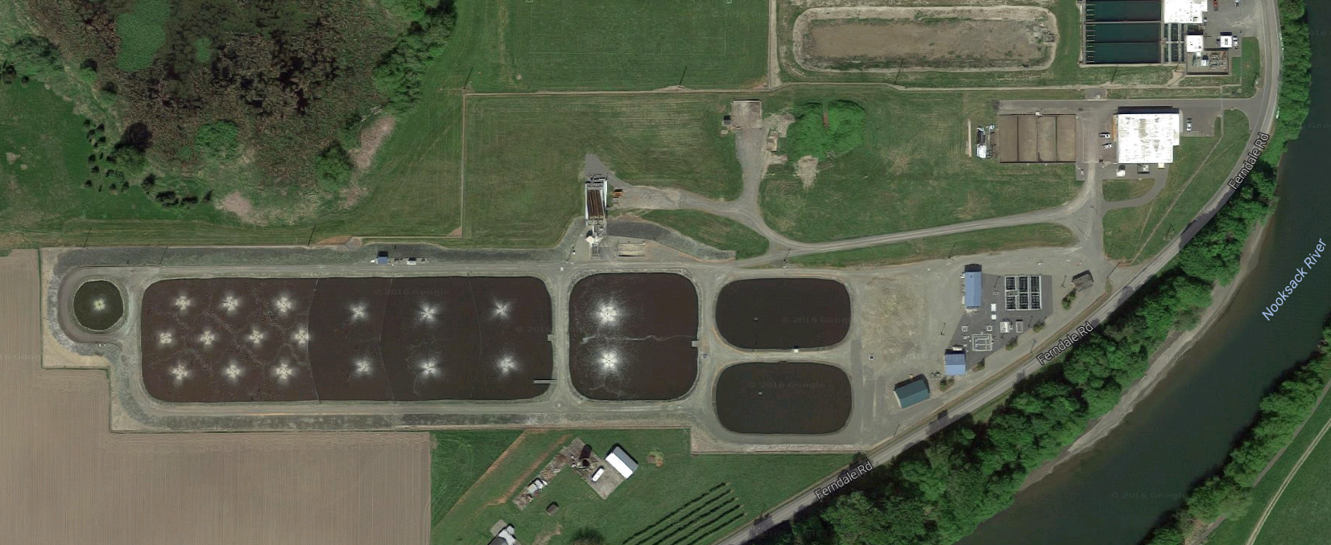
Project Description – Existing Conditions
FERNDALE WWTP
Last Major Upgrade in 1999
Existing Plant Capacity:
  95% - ADF
  80% - MMWWF
Condition & Reliability
Age & Life Expectancy
Notes:
\

Slide 5
Project Description – Proposed Improvements
Proven Treatment Technology
Small Footprint fits within Existing
Low Capital and O&M Costs

Slide 6
Proposed Funding Method
Funding: Anticipate Washington Department of Ecology
State Revolving Funds (SRF Grant and Loan Program). Funding applications are due Sept. - Oct. 2017. Funds available after July 1, 2018.
SERP: State Environmental Review Process.
This includes: SEPA, Public Meeting, and Cost Effectiveness Analysis.

Slide 7
DISCUSSION – PART II
Discussion of Environmental Impacts
    Cultural Resources Review
    Wetlands Assessment
    SEPA Review (including floodplain and shoreline impacts)

Slide 8
Project Discussion – Environmental Impacts

Slide 9
DISCUSSION – PART III
    Discussion of Alternatives, Costs, and Rate Impacts
    a. Alternatives
    b. Cost Comparison
            Capital Costs
            Operation & Maintenance Costs – Life-Cycle
        c. Nonmonetary Considerations
        d. Rate Impacts

Slide 10
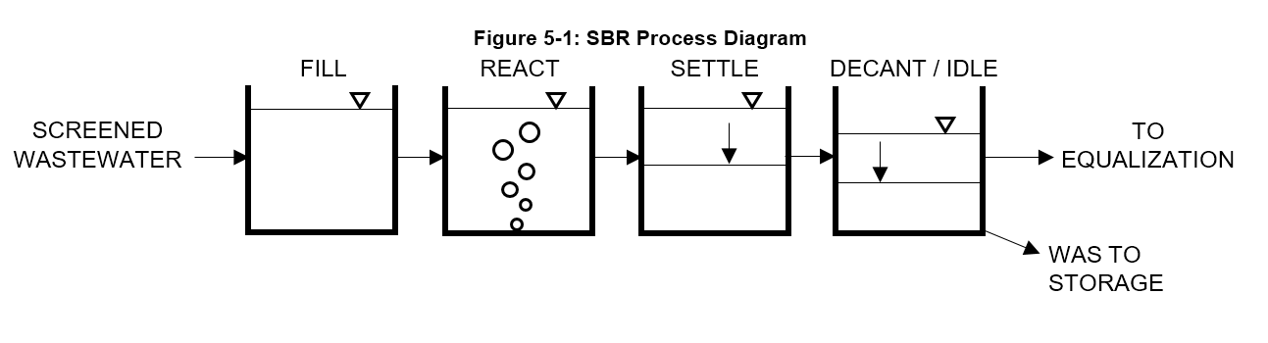
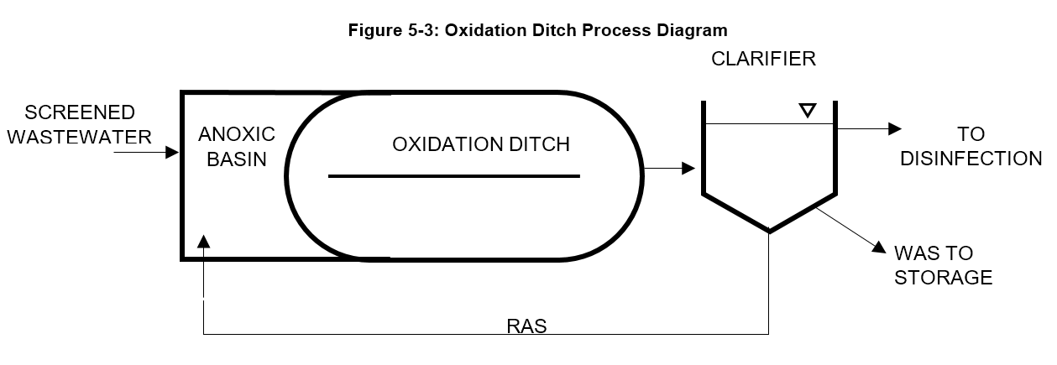
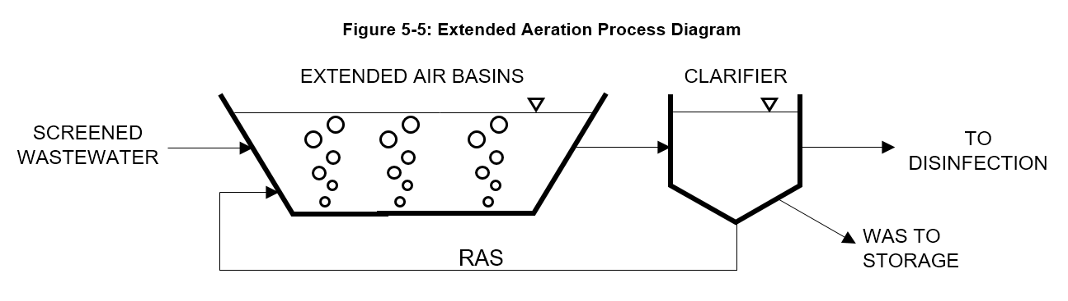
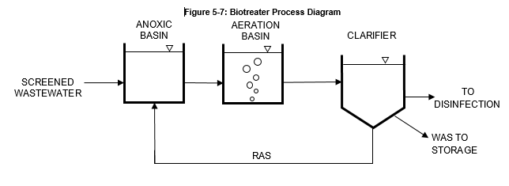
Alternatives
EVALUATION
Treatment Effectiveness
Operations Requirements
Physical Size
Cost – Capital and Operations
Selected Process
Notes:
Advantages and disadvantages of each alternative

Slide 11
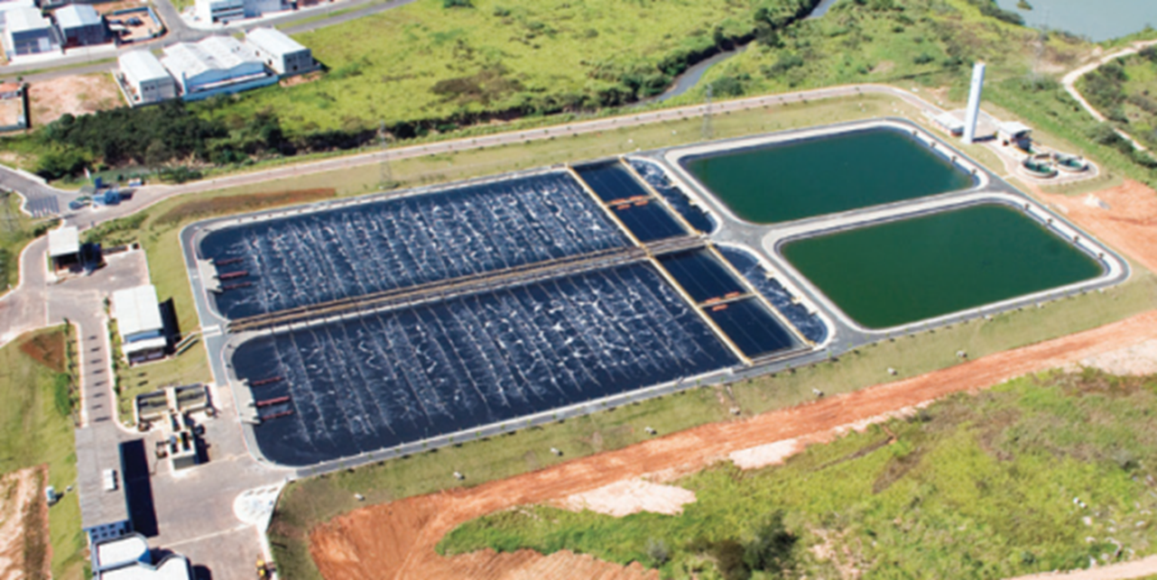
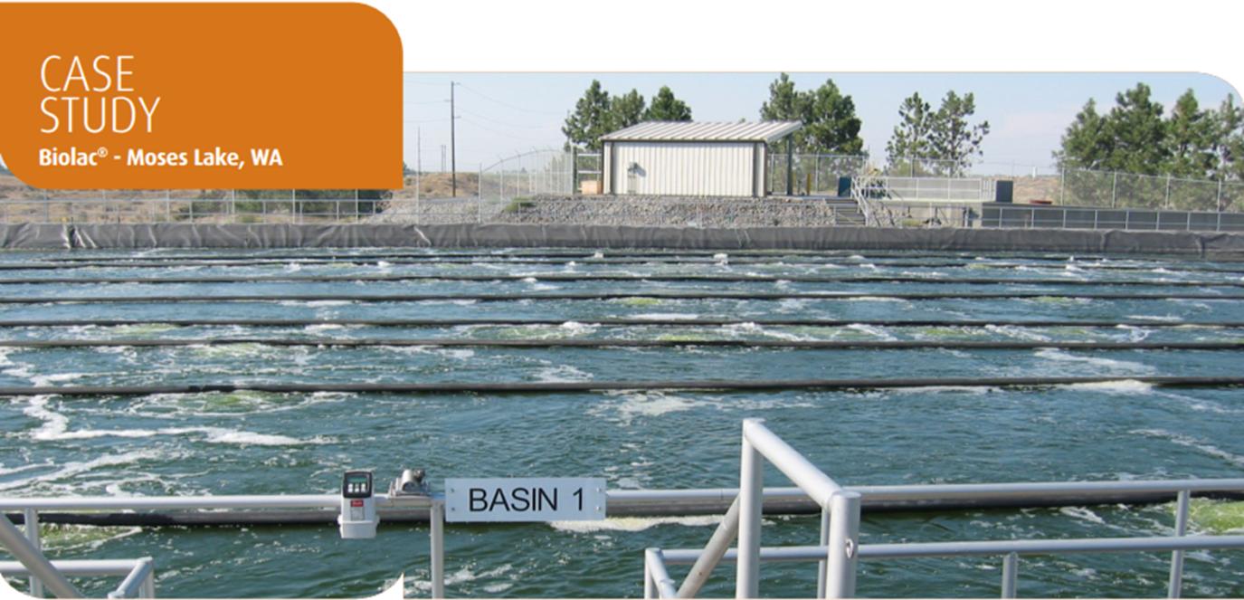
Project Description – Proposed Aeration Basins
Aeration Basin
Utilize Existing Basins As Much As Possible
Robust Extended Air Process
Fine Bubble Diffusers
Notes:
\

Slide 12
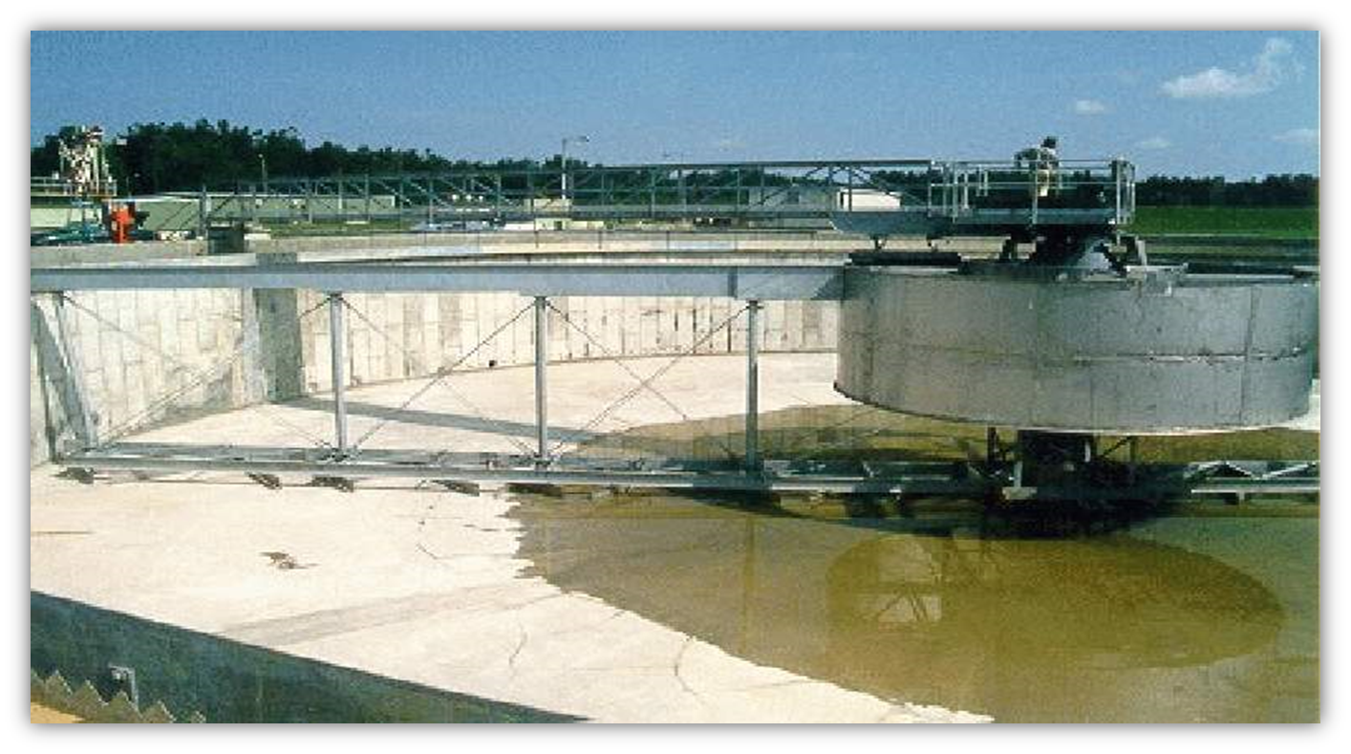
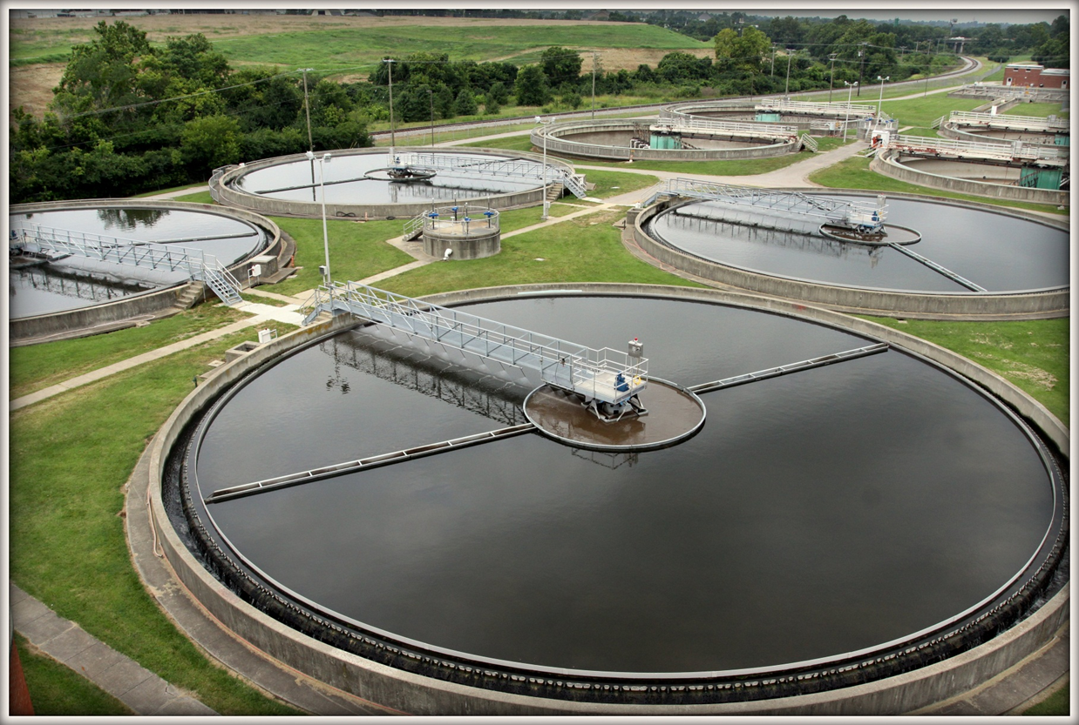
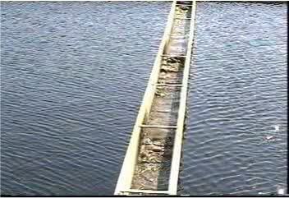
Project Description – Proposed Clarifier Technology
Suction Style Clarifier
Viewable RAS Return System
Central Feed Configuration
Easy to Remove Drive System
Notes:
\

Slide 13
Nonmonetary Considerations
Proven Treatment Technology
Straight Forward Process
Flexible Layout

Slide 14
Future Expansion Considerations
FUTURE AERATION BASIN
FUTURE CLARIFIER
FUTURE UV EQUIPMENT
Room for Future Expansion

Slide 15
Cost Comparison
Process Alternatives | Equipment Cost | Construction Cost | TOTAL | Annual O&M Cost | 20 Year Life Cycle Cost
SBR | $3,577,000 | $16,881,431 | $20,458,431 | $1,167,103 | $53,926,848
MBR | $9,441,000 | $22,904,283 | $32,345,283 | $1,622,728 | $78,879,420
Oxidation Ditch | $2,790,000 | $18,200,160 | $20,990,160 | $846,743 | $45,271,782
Biotreater Process | $3,117,000 | $19,402,336 | $22,519,336 | $1,241,575 | $58,123,357
Extended Aeration | $3,171,000 | $14,611,519 | $17,782,519 | $760,117 | $39,580,003

Slide 16
DISCUSSION – PART IV
    IV. Public Comment Opportunities
    a. Comments at Meeting
    b. Written Comments Regarding Meeting Tonight Please provide comments in next two weeks. Deadline = July 31, 2017
    c. SEPA
    - Advertised on June 28, 2017 and July 5, 2017

